Slide 1

Crown Entity Board Induction

Slide 2

















Context and overview
Crown entities deliver a wide range of public facing services across many sectors that New Zealanders rely on every day
The governance, capability and performance of Crown entities is critical for delivering improved results and outcomes
Transport and public safety
Health
Education
Housing
Business and finance
Business and finance

Slide 3




Context and overview
The Prime Minister and Ministers have signalled clear expectations that they are expecting improved performance and value from Crown entities.
Delivery of core functions
Delivering their core roles, reducing effort and resources on activities that are not driving delivery, driving improved results and value for the citizen customers they serve
Improving value
Driving improved value and fiscal sustainability, ensuring respect for taxpayer funds, including regularly ‘running the ruler’ over all expenditure to ensure entities maximise public value
Removing barriers to delivery
Removing barriers to delivery, simplifying processes and reducing complexity, and having a ‘can do’ attitude to make things happen

Slide 4
Public sector context
There are some wider challenges the public sector needs to respond to, to ensure it is better prepared to deliver for the future
High compliance and integration costs
Duplication and inefficiencies across agencies
Poor citizen experience due to disconnected services
Continued growth in expenditure, FTE and functions
Limited uptake of digital and AI tools
Declining value and questions over productivity
Fragmented model that is often too slow to respond

Slide 5
Direction for the public sector
We need to start moving towards a more optimal future state to better respond to the needs of citizens
The Public Service Commissioner has identified priorities that will inform the case for change in the public sector operating model:
Fewer, smarter agencies - reduce the number of departments, and group by how citizens interact with government.
Digital-first transformation - accelerate adoption of digital technologies and AI to streamline services and reduce costs.
System-wide co-ordination - centralise decision-making and investment in digital infrastructure for greater efficiency and value.
Reduced complexity and compliance
Stronger centralisation
Common digital platforms
A stronger focus core business
A different way of organising e.g. clusters, structural options

Slide 6


Enduring Letter of Expectations
The Minister for the Public Service and Minister of Finance issued an updated Enduring Letter of Expectations for Statutory Crown entity boards in April 2024.
Drive greater value from funding and public assets, and understanding reprioritisation should be used to deliver better results
Full understanding of entity cost drivers and performance against key outcomes, and clearly account for these in reporting
Take a continuous improvement approach to activities and programmes, incorporating evidence and evaluation practices to improve services

Slide 7
Crown entities are part of government and are owned by the Crown. Establishing a Crown entity reflects a decision by Parliament that a function or functions should be carried out at ʻarmʼs-lengthʼ. The Crown Entities Act provides the framework for establishing, governing and operating all categories of Crown entities. It also clarifies the roles, responsibilities and the accountability relationships between Crown entities and their boards, responsible ministers, and their departments. Ministers are answerable to Parliament for overseeing and managing the Crown's interests in, and relationships with, the Crown entities in their portfolios.
What is a Crown entity?
Types of Crown entities
Crown entities are defined under the CEA as falling within five main categories:
Statutory entities comprising:
Crown agents (e.g. ACC, NZTA)
autonomous Crown entities (ACEs, such as Te Papa)
independent Crown entities (ICEs, such as the Commerce Commission)
Crown entity companies (e.g. Crown Research Institutes, and other companies such as Radio New Zealand)
Crown entity subsidiaries
School boards of trustees
Tertiary Education Institutions

Slide 8
Crown Entities Act 2004 (some important sections)
Board members have an individual and collective duty to their responsible Minister (ss49-57)
Individual duties include acting with honesty and integrity, acting with reasonable care, diligence and skill, and in good faith and not at the expense of the entity’s interest (ss53-57)
The board’s collective duties include the board ensuring that:
the entity performs its functions efficiently and effectively, and in a manner consistent with the spirit of service to the public (s50)
the entity operates in a financially responsible manner (s51)
Conflict of interest provisions are more specific than those of many private boards (ss62-72) – if in doubt, it is best to reach out to your monitoring agency and the Commission for advice
The Code of Conduct for Crown Entity Board Members applies to all statutory Crown entity board members and should be read in conjunction with the duties above
Chief executive employment and remuneration (s117). The board must obtain the written consent of the Public Service Commissioner before—
(a) finalising the terms and conditions; or
(b) amending any or all of the terms and conditions once they have been finalized.

Slide 9
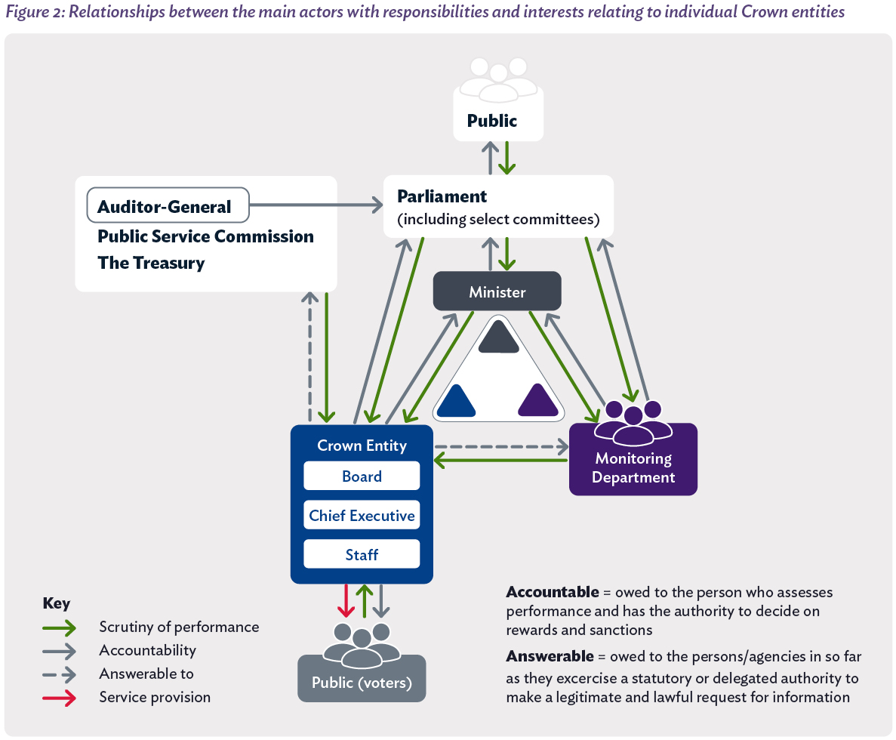
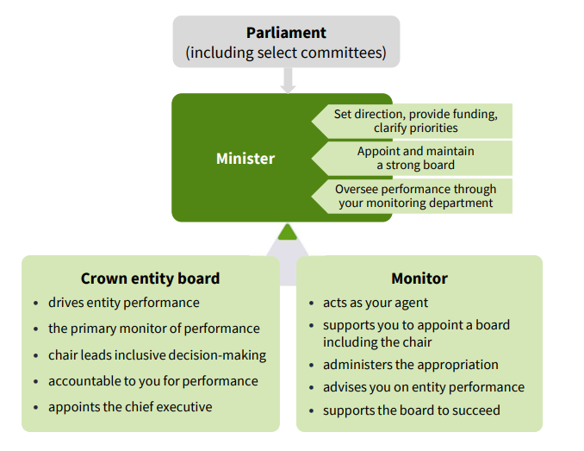
Crown Entities Act 2004 – the ‘it takes three’ relationship

Slide 10




It takes three addresses four main principles in detail, applicable to all three parties, often in quite different ways
Clear roles and responsibilities – a shared understanding of roles and responsibilities, statutory accountabilities and no surprises.
Strategic alignment i.e. relevant agencies are driven by the same principles, contribute toward the same outcomes AND achieve cross-government engagement with Crown entities and other parts of the relevant sector.
Efficient and effective monitoring – a high-trust relationship with your monitoring department matters. The monitor has a statutory responsibility to provide the Minister with independent advice. This is only possible when a rich information trade exists between the entity and monitor.
Trusted engagement – where relationships are trusting and productive for all parties.

Slide 11
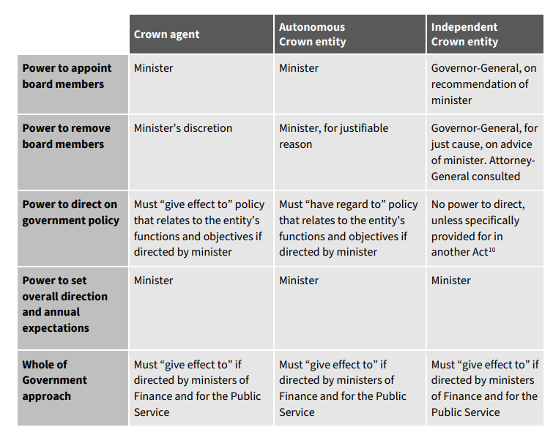
The extent to which a minister has control over a statutory Crown entity varies by category. Ministerial powers to direct on government policy vary depending on the type of statutory entity. There are some limits to Ministerial powers, for instance they cannot give directions to a Crown entity on a statutorily independent function and cannot direct a Crown entity, board member, employee or office holder to provide a service to, or bring about a particular result, in respect of a person or persons.
Ministerial control

Slide 12
Ministerial Levers for driving Crown entity performance
HARD LEVERS
Board appointments/ removal
Ministerial Reviews (s.132 CEA)
Ability to direct on Govt. policy (Crown Agents)
Direct whole of govt. approach
Direct whole of govt. approach
Ministers have a range of hard and soft levers to drive the direction, capability and performance of Crown entities.
Driving Crown entity performance and value relies on strong relationships between Ministers, Crown boards and monitoring departments, and using the right mix of levers at the right time.
Statement of Intent
Statement
Statement of Performance Expectations
Annual Reports
Key statutory accountability documents
Ability to request information
Crown observers/monitors
Ministerial Oversight Groups
Independent Board Evaluations
Letters of Expectations
Enduring Letters of Expectations
Baseline funding reviews
Monitoring/assurance assessment of Crown entity functions
Monitoring/assurance assessment of Crown entity functions
Regular Chair/Minister engagement
Regular discussion with monitors
Performance reporting from board and monitor
Engagement with stakeholders on entity performance
Engagement with stakeholders on entity performance
Active performance monitoring
SOFT LEVERS

Slide 13
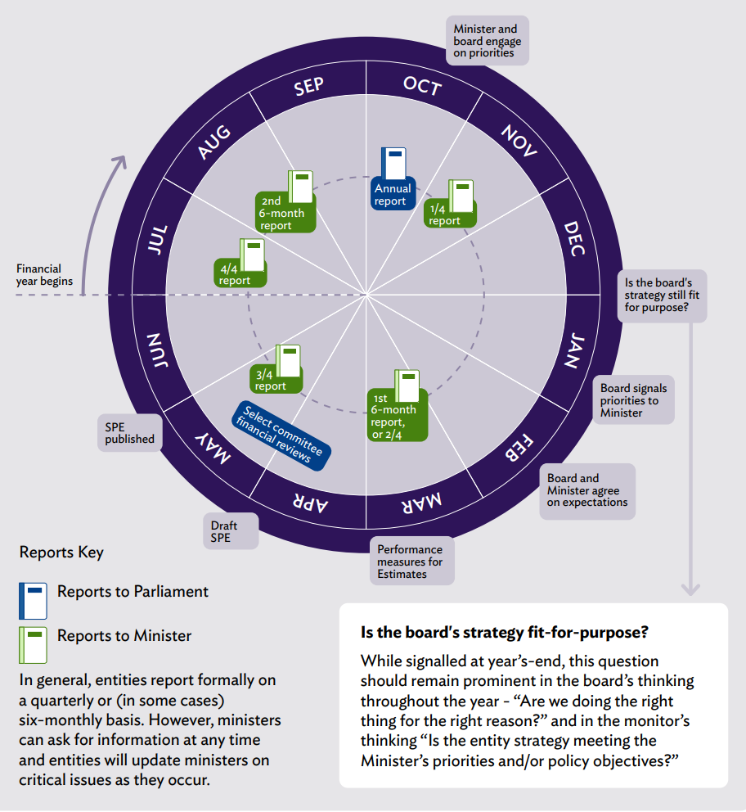
The Accountability Cycle for Crown Entities

Slide 14
What are the critical ingredients for driving better performance?
STRATEGIC ALIGNMENT
Clear alignment on Ministerial expectations and priorities
Alignment on performance expectations against the entities core functions
Strong engagement between the responsible Minister, Crown entity board and executive, and monitoring agency on priorities and performance expectations.
DELIVERY
An experienced and capable chief executive providing effective and visible leadership across the organisation and sector
Clear intervention logic between strategic priorities that translate into core delivery across the entity
Funding and resources directed towards services and activities that are effectively designed and evidence-based
Effective planning and governance systems to support delivery execution into the entity, linked back to entity functions and priorities.
STRATEGIC ALIGNMENT
DELIVERY
DRIVING CROWN ENTITY PERFORMANCE
PERFORMANCE AND VALUE
Active performance conversations between Ministers and Crown entity boards
Interventions and action taken in real time to drive delivery based on robust performance insights
Regular monitoring, evaluation and continuous improvement across functions
Active reprioritisation of funding based on effectiveness of functions and services.
PERFORMANCE
ACCOUNTABILITY
A strong, capable and experienced board that effectively can hold management accountable for delivery
Robust and frequency reporting on governance effectiveness, delivery of statutory functions, financial management and performance, and risk
Frequency engagement with the Minister and Board to discuss delivery and performance.
ACCOUNABILITY

Slide 15
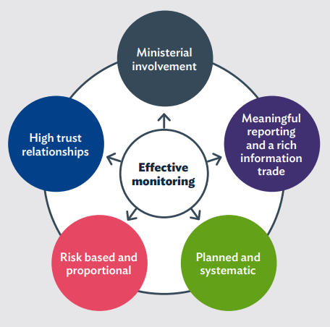
What does good monitoring look like and what can you expect from your department?
Responsible Ministers expect timely reporting from your monitoring department that:
is comparable over time
contains analysis and monitoring judgements on key financial and non-financial issues and performance risks
identifies future implications or trends
provides clear information on options if action is required to drive performance and results.

Slide 16
How can Central agencies help drive Crown entity performance?
Central agencies have levers and expertise that can support officials and Ministers to drive delivery, performance and value through Crown entities. There are different ways we can support officials to use the levers available to Ministers and the Central agencies summarised below
Assess
Central agencies can provide independent advice and insights to support you and your Ministers in understanding how Crown entities in your portfolio are performing and delivering value.
Examples:
Central Agencies can provide independent and second opinion advice on a range of issues, including organisational delivery, capability and performance; workforce management; governance effectiveness; assessing value-for-money.
Assist
Central agencies can work alongside you and your Ministers to support use of Ministerial levers to assist in setting the strategic direction, expectations and performance monitoring of Crown entities.
Examples:
Support for assessing governance performance and identifying talent for boards
Support for Ministers to develop and establish Crown monitoring/oversight arrangements
Central agency engagement with boards to provide context and drive action in priority areas
Working with Ministers and monitoring agencies to deploy performance levers e.g. use of accountability levers and documents, letters of expectations, Ministerial/monitoring reviews
Advice on monitoring/assurance assessments
Support on best practice Crown board appointments
Assess
Intervention
Central agencies can support Ministers/Boards to deploy targeted interventions, including levers available at the centre, to drive performance.
Examples:
Sprint teams to drive turnaround and programme delivery, including development of turnaround plans
Central agencies operate as board observers
PSC actively managing workforce bargaining
Targeted reviews – Performance Improvement Reviews/Spending Reviews/Performance Plans
Active Central agency performance monitoring
Central Agency Support
Assist
Intervention

Slide 17
Integrity and Conduct
As an apolitical Public Service, our reputation stands and falls on being trustworthy, transparent and impartial. It is vital public servants adhere to the expectation placed on them and maintain the trust and confidence of New Zealanders
Public trust in the Public Service remains high, but it is not guaranteed. It can be quickly undermined by actions that breach expectations or compromise perceived integrity.
Common risk include:
Poorly managed conflicts of interest
Behaviours inconsistent with political neutrality requirements
Lack of transparency around sensitive expenditure or organisation performance
Failing to uphold the no surprises convention – Boards must keep responsible Minsters and monitoring departments appropriately informed.

Slide 18
Code of Conduct - for Crown Entity Board Members
Issued under section 17(3) of the Public Service Act 2020, this Code applies to board members of most statutory entities and Crown entity companies. It outlines expectations for integrity, professionalism, and lawful conduct to maintain public trust.
Key Principles:
• Integrity - Be honest, fair, and respectful; speak up on matters of public interest.
• Professional Conduct - Avoid conflicts of interest, misuse of resources, or inappropriate political activity.
• Use of Information - Handle official information responsibly and lawfully.
• Lawfulness - Comply with all legal and administrative obligations; support collective board decisions.
• Implementation - Boards should adopt governance practices that reflect and support these standards
To read the full Code of Conduct - Code of Conduct For Crown Entity Board Members

Slide 19
Key takeaways
One source of funding – the taxpayer
Accountability for performance – need to have a critical eye on who the agency serves and the quality of that service
Context matters – stakeholders and operating environments are different
Trust and confidence is a bottom line – it’s our licence to operate from the New Zealand public
Relationships matter – Minister, sector, Crown monitor/policy agency, central agencies
Crown boards have a critical role to uphold integrity and conduct in the public sector
Crown boards exercise independent statutory functions, but are not independent from Government
Small things that might seem insignificant in a private context can have significant implications within a public sector context (e.g. sensitive expenditure)
‘No surprises’ is an important principle for how we work

Slide 20
Resource and Guidance Material
Public Service Commission Resources and Guidance
Crown entities - Te Kawa Mataaho Public Service Commission
Code of Conduct for the Public Sector
Resource for Preparation of Governance Manuals
Government Workforce Policy Statement
Guidance for Crown entity monitoring
All-of-Government Requirements and Expectations on Statutory Crown Entities
Guidance: Officials and select committees - Te Kawa Mataaho Public Service Commission
Model standards are the Public Service Commissioner’s minimum expectations for staff in the public sector. These include:
Conflicts of interest
Chief executive gifts and expenses​ (mandatory annual compliance and disclosure)
Speaking up
Workforce assurance
Positive and safe workplaces
Working with survivors
Information gathering and public trust
Learning Development Centre - A business unit within Te Kawa Mataaho Public Service Commission. The Leadership Development Centre (LDC) is the primary vehicle for delivering public sector leadership development.
Other useful guidance from:
Office of the Auditor General (OAG)
Managing Conflicts of Interest
Controlling sensitive expenditure: Guide for Public Organisations
The Treasury
Preparing the Annual Report and other End-of-Year Performance Reporting: Guidance for Crown Entities

Slide 21
Key contacts at the Public Service Commission
Crown Entity Resource Centre
Email: CERC@publicservice.govt.nz

