Slide 1
What are Crown entities and where do they fit in a picture of the public sector?

Slide 2
How are statutory Crown entity boards different from commercial or NGO boards? (1)
Ministerial influence
The responsible Minister (the sole shareholder) is answerable in Parliament for the agency’s performance, and is likely to expect a higher level of interaction with the board than shareholders would with a commercial board.
Role, function, strategy and priorities
A Crown entity’s role and functions are generally set out in legislation, and boards have little or no discretion. Legislation may also prescribe how they operate.
The Minister and Cabinet are likely to define the entity’s strategy and policy context. The Minister may set high level delivery priorities for a Crown entity that in a commercial company or NGO would be set by the board.
Monitoring and transparency
The Minister appoints a monitor to provide them with independent advice on the Crown entity’s strategic alignment, performance, capability and management of risk. The monitor’s role is set out in the CEA (s.27A) includes the power to seek information from the board. This role goes beyond interactions a commercial board may typically have with a shareholder representative.
Notes:
This and the next two slides contrast public sector and private sector governance. The differences are explored in more detail further on – but for now, set the scene for thinking about your role as a Crown entity board member

Slide 3
How are statutory Crown entity boards different from commercial or NGO boards? (2)
Funding and financing
Crown entity boards have little discretion in raising capital. Funding can generally only be secured though a Budget bid process. Access to borrowing is also tightly controlled, whether borrowing from the Crown or commercially.
Crown entities that charge fees, and/or levies for services also have little or no discretion in adjusting prices. These can generally only change by approval from Parliament, Executive Council or Ministers following a funding review which in turn involves public consultation.
Public scrutiny and accountability
Crown entities experience a high level of public scrutiny and accountability. A Crown entity board is directly accountable to Parliament (CEA Part 4), as well as to the Responsible Minister (CEA S.26), and the Chair may be summoned to answer select committee questions on conduct and performance. The Official Information Act and Public Records Act apply.
More generally, Crown entities are often much more in the public eye than a commercial or non-government organisation, often with strong media interest.

Slide 4
How are statutory Crown entity boards different from commercial or NGO boards? (3)
Government standards, processes and operating expectations
The Crown Entities Act sets out specific requirements of boards and directors on issues such as conduct and integrity that go beyond those required of commercial or NGO boards.
Ministers expect entities to embody the Government’s good-faith and collaborative approach to Māori-Crown relations not generally applicable to commercial organisations and NGOs.
The Crown Entities Act gives the Public Service Commissioner a statutory role in relation to Crown entities. For example, boards must obtain the written consent of the Public Service Commissioner before formalising their chief executive’s employment terms and conditions.
There are other all-of-government requirements on boards, such as the Government Workforce Policy Statement.
Measures of success
As part of government, Crown entities are expected to deliver and measure success against a wide set of economic, social, environmental and cultural outcomes, set out in the Living Standards Framework. In addition, they are often expected to work across organisational boundaries. This is a more complex operating environment than is faced by most commercial and NGO boards.
Notes:
Crown entities are legally separate from the Crown - in some cases a court may decide that the Crown is liable for the agency. This will depend largely on its statutory functions and the extent of control exercised over the entity by Ministers and other central government agencies. Every board should spend time discussing these matters as they relate to themselves and their employees, preferably with the assistance of a trained specialist, perhaps the entity's legal advisor.
Protection from liability
S120 of the Crown Entities Act (the Act) provides that a member is not liable for any liability (civil or criminal) of the entity by reason only of being a board member.
Extent of immunity
The Crown entity itself has no 'blanket' immunity; nor do members, employees, or office holders have immunity from criminal liability.
However, the Act does provide that where a board member (office holder or employee) acts in good faith and in performance, or intended performance, of the entity's functions, that board member is immune from civil liability in respect of that act or omission unless:
it is also a breach of an individual duty of a board member under any of ss. 53 to 57 of the Act (s. 121 Act); or
the responsible Minister or entity personnel apply to the court for an order to ensure a member's compliance with the law (s. 60 Act).
The Act provides that members of an entity are immune from civil liability unless they have breached an individual duty set out in the Act. It also contains express powers for a board to indemnify its members, employees, office holders and committee members at the board's discretion for acts or omissions done in good faith and in the performance or intended performance of the entity's functions (s. 122).
[For more information on indemnity see Chapter 19 of the Resource for Preparation of Governance Manuals in the Commission website]

Slide 5
What are Crown entities and where do they fit into the public sector?
Constitutional
Monarchy
(represented by
Gov-General)
Legislative Branch
Parliament
Makes
law
Executive Branch
Government
Develops and
administers law
Judicial Branch
Courts, Tribunals
Interprets and
applies law
The basic elements of New Zealand’s system of Government
Notes:
Parliament (the Legislative Branch)
New Zealand is a constitutional monarchy. The Sovereign, through her representative the Governor-General, is the Head of State (State authority is known therefore as The Crown). However, the powers exercised by the Queen and the Governor-General are done so on the advice, and with the support, of elected representatives of the people. New Zealand operates in effect as a Parliamentary democracy.
The House of Representatives makes laws, though they must be assented to by the Sovereign’s representative before being enforceable. The House holds the government of the day to account and scrutinises its performance on behalf of the people of New Zealand.
The Executive
Crown entities are instruments within the Executive Branch.
After each election the party (or grouping of parties) that holds sufficient seats to be assured of the confidence of the House of Representatives will become the Government of the day. From that party or parties are appointed the Ministers of the Crown, who assume specific responsibilities in relation to the operations of the state, including the funding of these operations.
Ministers are supported by government departments or Ministries whose roles include policy advice and briefings, assistance in the discharge of Ministerial obligations in relation to organisations owned or funded by the Crown, and administration of appropriations on behalf of Ministers.
Public Service departments are explicitly apolitical: they serve the policy interests of the Government of the day but do not involve themselves in politics. Crown owned organisations such as Crown entities are established by Parliament through legislation: they set their strategic direction in accordance with the interests of the Crown as well as the terms of this legislation. They are not subject to the political imperatives of the party to which their ‘responsible’ Minister belongs.
Ministers, together with their departments, form what is known as the Executive Branch of government. Ministers form the Executive Council, where Ministers act as advisors to the Governor-General, who presides over the Executive Council. On the recommendation of these advisors, the Governor-General authorises a range of processes and appointments, and formally assents to the creation of new legislation.
The Judiciary is responsible for interpreting and applying the laws that are made by Parliament.

Slide 6
New Zealand’s system of Government includes
Executive Council
The highest formal instrument of government, constituted by the Sovereign’s Letters Patent
The institution through which the government collectively and formally advises the Governor-General
Comprises all Ministers of the Crown who derive their power to advise the Sovereign and Governor-General from membership of the Executive Council
Cabinet
Established by convention, with no constitutional basis. Powers are held by individual Ministers in their own right
An important forum for Ministers to work together to determine Government policy and processes – the ‘workhorse’ of government
Has a strongly enforced convention of collective responsibility
Supported by Cabinet Committees, eg the Appointments and Honours Committee (APH)
Caucus
Each party in Parliament has a caucus comprising all its MPs
Can be very influential, eg when the governing party has to depend on the vote of every MP within its sphere of influence
Government caucus are often consulted on for board appointments
Notes:
The Cabinet
Cabinet - and Cabinet committees - are key mechanisms for determining Government policy and processes. Cabinet is in fact an informal arrangement only: it does not have a constitutional basis. Ministers, in their own right, hold the powers conferred by the warrant of office from the Sovereign, and these powers are unaffected by whether the Minister is a member of Cabinet, or a Minister ‘outside Cabinet’. Nevertheless, Cabinet is the means by which a great deal of Government business is undertaken, where substantive discussion takes place on issues of both policy and politics, and where important decisions are effectively made.
Ministers are bound by the strongly enforced convention of collective responsibility to respect the decisions of the Cabinet, whether or not they were present at the time that decision was made, or whether or not they personally agree with it, though there are some situations where Ministers who are members of a coalition party supporting the government may ‘agree to disagree’.
As well as the impact of Cabinet policy decisions on the business of Crown entities, the Cabinet Appointments & Honours Committee (APH) discusses Ministers’ recommendations on all but the ‘most minor appointments’.
Caucus
Each party has regular meetings of all its MPs, who are known collectively as the party’s caucus. Caucus meetings provide MPs with the opportunity to consider a range of policy and political issues. It is at Government caucus meetings that Ministers respond to the concerns of backbench MPs about initiatives of the Executive, and often seek the agreement of all caucus members to a proposed plan of action. At times when the Government’s majority is small (or when it is in fact operating as a minority Government dependent on the ongoing support of other individuals or parties) the agreement of the full caucus can be crucial. Without such agreement, the Government can be effectively prevented from taking any action or, at worst, lose of the confidence of the House, the ultimate result of which is the calling of a general election.
Government caucus is often consulted on appointments to boards of Crown entities and other bodies.

Slide 7
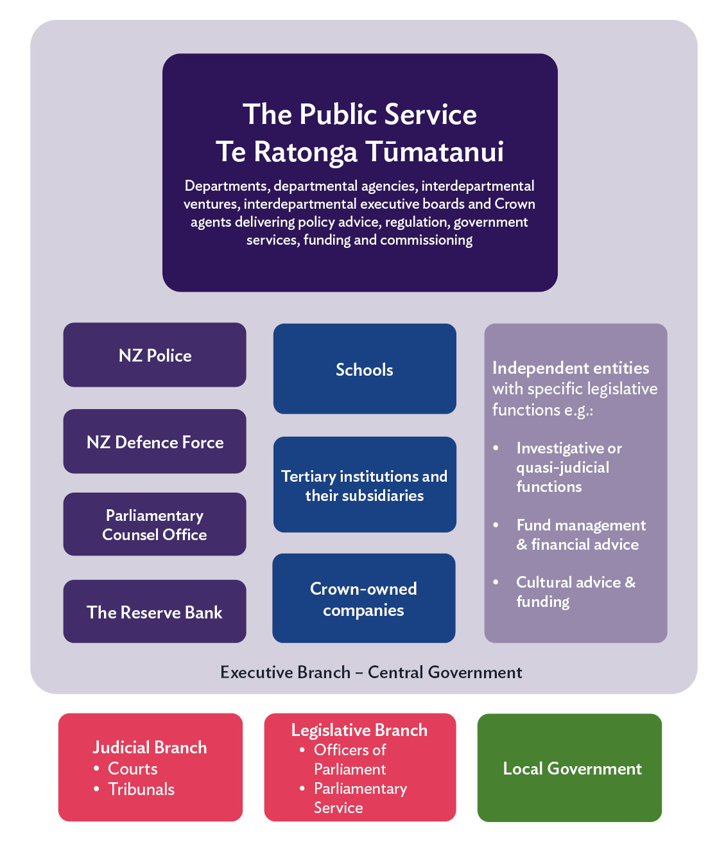
Schematic of the wider public service and where Crown entities fit

Slide 8
Crown entities are a critical part of the public sector and a ‘unified’ public service
They constitute a wide variety of public sector organisations delivering many public services
They are often the ‘face of government’ delivering:
almost all public health, education, transport and housing services
key regulatory functions.
Crown entities are collectively responsible for:
more than a third of total government expenditure
the management of approximately 2/3 of the Crown's physical assets
over half the workforce employed in the public sector.

Slide 9
On one hand, they are ‘stand-alone’, but on the other:
Government-owned, Crown entities are separate from the Crown - legal entities in their own right
Because of their functions and the nature of their work they are designed to operate at appropriate 'arms length’ from Ministers because, for example:
decisions on individual cases should not be influenced by Ministers
Ministers should be distanced from operations
entities require access to a broad range of skills
board appointments enable government to harness skills from the private and non-profit sectors.
However, Ministers are still answerable to Parliament for entities’ performance
Notes:
Being at arm’s length from Ministers means Crown entities have varying measures of independence in making decisions (e.g. regulatory or funding decisions).
Reasons for this distance are, for example:
Decisions that relate to individuals should be seen to be not influenced by Ministers (e.g. as to who is issued a Driver’s Licence).
Ministers should have some distance from the operations of the entity (e.g. management decisions in a hospital, or where the decision applies to the Crown).
A Board can bring a broad range of skills to the governance of the entity (e.g. investment management skills for boards of Crown financial institutions, engineering skills for boards of entities with infrastructure investments).
Some entities have statutorily independent functions especially around regulatory decisions, and this means that Ministers are particularly distanced from such decisions.
However, all Crown entities are part of the State sector, regardless of:
the deliberate ‘arms length’ nature of their design
the extent to which they are funded by the Crown (some Crown entities obtain funding from non-government sources)
the degree of statutory independence a particular Crown entity might have.
This means that they operate as instruments of the Crown in respect of the government of New Zealand. This should be reflected in appropriate standards of behaviour by Crown entity board members and employees.
Ministers still remain responsible to Parliament for Crown entities’ performance, and entities must report on all aspects of their activities transparently.

Slide 10
The legislative framework for Crown entities
The Crown Entities Act 2004
Provides a consistent framework for the establishment, governance and operation of Crown entities.
Clarifies accountability relationships between Crown entities, boards, responsible Ministers and Parliament.
Clarifies powers and duties of board members.
The entity’s own Act - can supplement, negate or modify any provisions of the Crown Entities Act
Other legislation, e.g.:
Public Service Act 2020 Public Finance Act 1989
Companies Act 1993 Official Information Act 1982
Ombudsmen Act 1975 Public Audit Act 2001
Various Acts relating to employment and human rights
Notes:
The Crown Entities Act prevails unless the entity’s own Act expressly states otherwise. Each entity's specific Act (s.4 CEA) can supplement, negate or modify any of the provisions of the CEA. Boards need to be familiar with their own entity’s legislation and understand how it interacts with the CEA (and other important legislation).
Crown entity board members should also be aware of the impact of the CEA and other legislation on their decision making or practices. For example, the CEA requires Crown entity boards to obtain the Public Service Commissioner’s (the Commissioner’s) consent on the terms and conditions for all Crown entity chief executives before they are appointed and when their remuneration is reviewed. The Public Service Act gives the Commissioner power to issue a Code of Conduct, to undertake or advise on machinery of government reviews, and various other functions.
Crown entities are subject to the provisions of the Official Information Act.

Slide 11
Te Tiriti o Waitangi / Treaty of Waitangi
Negotiated between the Crown and Māori. The Crown does not include Crown entities - but Ministers expect Crown entities to embody the Government’s good-faith and collaborative approach to Māori Crown relationships. This is set out in the Enduring Letter of Expectations.
A number of government agencies have guidance about applying the Treaty (and more commonly, its principles) in the course of their work. The New Zealand Productivity Commission reviewed 10 examples in 2014. More information can be found on the Commission’s report ‘Regulatory institutions and practice [The Treaty of Waitangi in regulatory design and practice].
The Māori Crown relationship continues post-settlement, and past conduct (even if settled) may inform what a reasonable and honourable Treaty partner will do in the future
For more information:
Te Tiriti o Waitangi / Treaty of Waitangi Guidance [CO (19) 5]
Te Arawhiti / Office for Māori Crown Relations Public Sector Capability Framework

Slide 12
Three types of statutory Crown entities
Crown agents
autonomous Crown entities (ACEs)
independent Crown entities (ICEs)
The differences between the types include the degree of separation from the Minister, reflected in provisions for board member appointments and removals, and ministerial powers of direction.
In addition to statutory entities, there are four other categories of Crown entity: Crown entity companies, Crown entity subsidiaries, School Boards of Trustees, and Tertiary Education Institutions.
The new Māori Health Authority is an independent statutory entity with some provisions of the Crown Entities Act in its establishment legislation

Slide 13
What are the differences between these entities?
Notes:
There are differences in the way board members are appointed (and removed) and the degree to which entities may be directed on ‘policy’ matters relating to the individual entity’s functions and objectives.
Boards of ACEs should interpret the requirement to have ‘regard to’ government policy as requiring them show evidence of having given genuine attention and thought to the government policy on the matter before making up their own mind. More particularly, the question of what does ‘have regard for’ mean, comes up in Crown entity board induction sessions when we are explaining the difference between agents, ACES and ICEs. The following the words are general and not legal advice, but will help ACE boards determine the meaning of ‘have regard’ to a particular policy provision:
here’s the policy intent of the provision,
you should/might wish to take legal advice on what it means specifically for your entity
the courts are evolving their explanation of the phrase.
Ministers have powers with respect to all entities (s.27 CEA) on matters of strategic direction, targets, funding, performance, reporting and review, as long as the Minister does not interfere with any statutorily independent function. Note that all functions of an ICE as set out in its statute are statutorily independent, and entities other than ICEs also can have statutorily independent functions.

Slide 14
Each Crown entity has a responsible Minister who …
oversees and manages the Crown's interests in and relationships with the entities that are within their portfolio
represents the public interest in the entity (and, in private sector terms, is the de facto ‘shareholder’)
ensures an effective board is in place to govern the entity
influences the entity’s strategic direction
monitors and reviews Crown entity performance and results
carries out any statutory responsibilities .
Note: The Ministers of Finance and for the Public Service also have important roles to play in the Crown entity sector, including issuing directions to support a whole of government approach.
Notes:
Note:
Crown entity companies have ‘shareholding Ministers’ (the ‘portfolio’ Minister and the Minister of Finance).
There are a number of aspects to a Minister’s role in ensuring there is an effective board with the requisite skills in place: appointment, reappointment, and removal of board members
Participation in setting the direction of Crown entities may include setting the direction for multiple agencies in a sector.
The Minister of Finance:
has oversight of the government’s fiscal and economic interests
has statutory responsibilities under the Crown Entities Act
is a shareholding Minister for Crown entity companies.
The Minister for the Public Service
has responsibility for all public services and the Public Service Commission which administers the Crown Entities Act (except Part 4 – administered by the Treasury)
can request Crown entities to supply information for the purpose of assessing the capability and performance of the public service (the request can only be made to a group comprising at least 3 Crown entities with at least 1 significant characteristic in common).
Together, these two Ministers may jointly direct all Crown entities to comply with specified requirements for the purpose of supporting a ‘whole of government approach’ (s.107 CEA).

Slide 15
Ministers expect boards to:
be aware of demands on Ministers from Parliament, taxpayers and other interested parties
accept that the Crown has interests wider than those of ordinary shareholders in private companies
understand (and embrace) wider Government policy issues as part of their decision- making
provide assurance of effective organisational performance (delivery of results) and conformance with statutory functions, powers, duties, etc
be aware of and keep Ministers informed about the potential implications of organisation-specific issues on the Crown
ensure their Crown entity behaves prudently and sensitively, and in keeping with public sector values.
Notes:
In a broad sense, Ministers expect boards to:
be sensitive to the demand for accountability placed on responsible Ministers from both Parliament and taxpayers who hold responsible Ministers directly answerable for the performance of Crown entities
accept that the Crown has interests wider than those of ordinary shareholders in private companies
understand wider Government policy issues as part of their decision-making
be aware of the potential implications of organisation-specific issues on the Crown and/or its balance sheet.
The collective and individual duties of board members are set out in the Crown Entities Act and are covered separately
Discuss: are there any other realistic expectations a Minister should have of the boards they appoint? Which of these would you think would be more important to a Minister? – These discussions will often be entity/portfolio or sector specific

Slide 16
The ‘no surprises’ principle
Boards have authority, but Ministers are ultimately answerable for the actions of their Crown entities to Parliament and the public.
Ministers expect to be informed as fully and as early as possible of any entity issues that may impinge on the Government’s responsibilities, or be potentially contentious.
Proactivity and timeliness in applying the ethos of 'no surprises' is essential to the integrity of the relationship, and to mutual trust and confidence.
A 'no surprises' way of working is not intended to interfere with entities' statutorily independent functions, nor with boards' operational responsibilities.
Note: Crown entities should apply the same ‘no surprises’ principles to their relationships with monitoring departments.
Notes:
Ministers expect to be informed well in advance (either directly or through the monitoring department) of any issue arising within an entity that may be contentious in the public arena, whether the issue is inside or outside the relevant legislation and/or policy. Boards should avoid ‘drip-feeding’ this information: it is better for Ministers to have the full story as early as possible.
Boards (particularly Chairs) need to be proactive on this. If in doubt, communicate!
Boards should have a reasonable expectation that Ministers will reciprocate in terms of ‘no surprises’.
Trusted working relationships between Minister/Minister’s office/Crown entity board and chief executive/monitoring department are essential, so that all parties have the confidence to make their concerns known.
While monitoring departments need to be kept in the loop, it is not their role to ‘filter’ such information going to the Minister.

Slide 17
Monitoring departments support responsible Ministers
Monitoring departments have a statutory role to assist the responsible Minister to carry out his or her role in relation to each monitored entity (no matter how they are funded).
This includes supporting Ministers in the process of identifying skill needs and appointing board members, and providing the Minister with information, analysis and advice on the entity’s effectiveness and efficiency .
The monitoring department is expected to focus on major opportunities and risks.
The Board is the first and primary monitor of performance.
Notes:
In some instances, Ministers may wish to have explicit agreements in place with thire monitoring department setting out the Minister’s monitoring expectations.
Monitoring departments are expected to focus monitoring activity on major opportunities and risks. Monitoring should be proportionate to:
the Minister's needs
the scale of investment in, and spending on, Crown entities
the risk posed by Crown entities
opportunities that could be realised across the Minister's area of responsibility.
The monitor should not be trying to duplicate the board’s work

Slide 18
Crown agents are part of the Public Service for some purposes
Under the Public Service Act, Crown agents are now bound by the same purpose, principles and values as public service departments and other public service agencies. Boards of Crown agents are responsible for ensuring that the entities they govern uphold the public service principles
These provisions are about strengthening the shared identity and underlying behavioural foundations of all public servants – regardless of where they work. It’s aimed at bringing them closer together, in the goal of serving New Zealanders, without fundamentally changing the governance of individual agencies.
All Crown entity boards should consider these aims for the entities they govern.
Notes:
Of the Crown entities, Crown agents are closest to government. They give effect to government policy, include core public-facing service delivery, and often need to work closely with public service departments to deliver public services. It makes sense for all Crown agents and public service agencies to be unified under a common purpose and common principles and values.
The Public Service Act includes provisions across five key areas that will help the public service join up services around New Zealanders’ needs and secure public trust and confidence, so it remains well placed to serve New Zealand in the future. The five areas are:
A unified public service
Strengthening the Crown’s relationships with Māori
Employment and workforce
Leadership
Organisational flexibility

Slide 19
Public Service Act and reforms continued …
For an overview of the Public Service Act: Purpose, Principles, Values, Māori Crown Relationships and Spirit of Service see https://www.publicservice.govt.nz/assets/SSC-Site-Assets/SAPG/Public-Service-Reform/Purpose-Principles-Values-1280x1024.pdf
For an overview of the Public Service Act and linkages to public sector reforms see https://www.publicservice.govt.nz/assets/SSC-Site-Assets/SAPG/Public-Service-Reform/Overview-of-Public-Service-Act-2020.pdf

