Slide 1
Ministers influence Crown entities in different ways

Slide 2
… by appointing and maintaining a strong and effective board
Appointments are mostly made by Ministers; ICE board members are appointed by the Governor-General .
Ministers’ recommendations for appointment almost always go to the Cabinet Appointments and Honours Committee (APH) and often to the government caucus.
Appointments are for a fixed term.
Appointees may be offered a second or subsequent term of office, but there is no guarantee of this.
Ministers and the Governor-General have powers of removal.
There is no compensation or other benefit for loss of office.
Notes:
Under the Crown Entities Act, the term of office for members of Crown agents and ACEs is up to three years, and up to five years in the case of ICE members. Appointments can be for less than the maximum period.
Some Crown agent and ACE boards include members who are elected as representatives of a particular 'constituency'. Their term of office is set by the terms of the relevant statute.
Some Crown entities have provision in their legislation for board members to be elected, co-opted or designated.
Members can be considered for a second or subsequent term of appointment.
Crown entity board members may choose to resign during or at the end of their term. Otherwise, they continue in office past the expiry of their term until either:
they are reappointed; or
their successor is appointed; or
they are informed they are not to be reappointed but that no successor is to be appointed.
These provisions are not to be used to justify delaying an appointment process.
It is good practice for Ministers to consult with board chairs when considering new appointments (or reappointments), to identify skill needs, succession planning, etc.
Removal from office
A Minister may remove a member of a Crown agent or an ACE from office before the end of the member’s term. The Minister can remove a member of the Crown agent entirely at his or her discretion. An ACE board member can be removed for any reason that in the Minister’s opinion justifies the removal. Elected members of Crown agents and ACEs may also be removed by the responsible Minister but only for 'just cause‘ (s.38).
An ICE member may only be removed for ‘just cause’, by the Governor General on the advice of the Minister after the Minister has consulted the Attorney-General.

Slide 3
…. by participating in ongoing dialogue and engagement with entities through:
Meetings
  Ministers typically hold regular meetings with the board chair (or with senior management, as authorised by the board) to discuss strategic issues. Monitoring department representatives will often be present.
  Ministers may also have periodic meetings with the full board.
Briefings
  Boards are expected to advise their Minister in advance of any major initiatives or developments.
  See also ‘no surprises’.
Regular reporting
  Entities provide their Ministers with regular performance reports.
Informal engagement between boards and responsible Ministers contributes to more formal processes within the strategic planning and performance cycle (see next slides).
Notes:
There is no single practice that is followed by all Ministers. Boards should work with their Minister’s office to establish the style of relationship that works best for the Minister concerned.
A high trust relationship between the monitor and board chair can help to inform the Minister’s relationship with the Chair

Slide 4
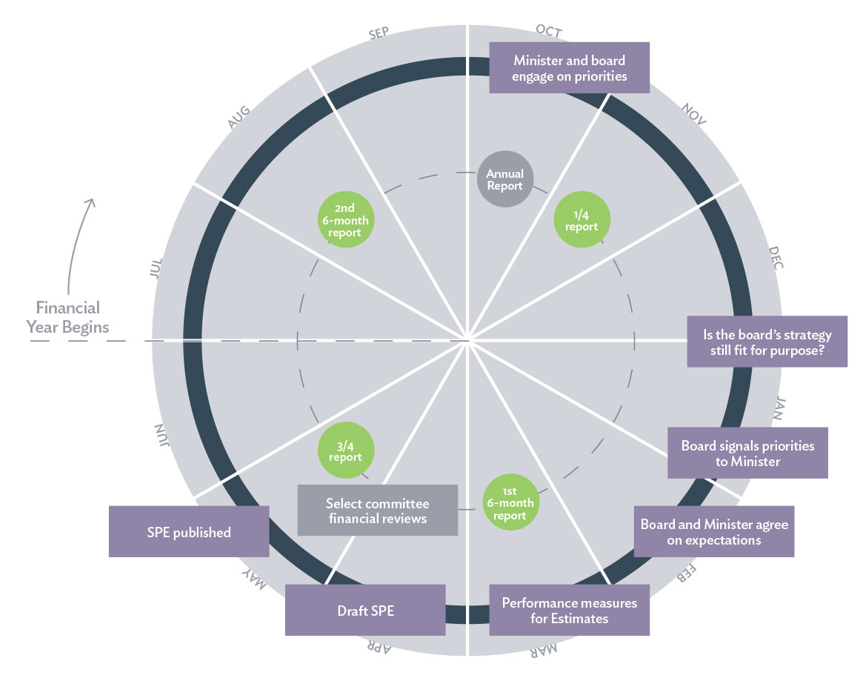
By participating in the strategic planning and performance cycle
Reports to Parliament
Reports to Minister
In general, entities report formally on a quarterly or six-monthly basis.
Ministers can ask for information at any time and entities will update Ministers on critical issues as they occur.
Notes:
In summary:
Direction setting = Letter of Expectations (optional)
Direction setting and Planning = SOI
Planning and Implementation/delivery = Statement of Performance Expectations
Implementation/delivery = Quarterly (or other regular) reporting
Review = Annual Report

Slide 5
Continuous improvement: the strategic planning and performance cycle
Set direction: Strategic intentions next 4 years - identity strategy, indicators & areas for change
Plan: best way to achieve objectives, our capability. Our best options
Implement, deliver & monitor: Are services delivered as planned. What do the recipients think? Are we managing our risks? Can we adjust?
Review: What was the impact of our interventions? How can we improve? What were the unintended consequences?
Depending on service complexity, these steps often align with stages in the strategic planning-performance cycle.
This approach can guide development of the entity Statement of Intent.
Notes:
This graphic illustrates steps boards need to consider.
In most circumstances, initiatives relating to each step will be undertaken contemporaneously.
In general, the timing of and supporting documentation for each step follows the performance cycle illustrated in the previous slide

Slide 6
Minister’s exert influence through the range of formal strategic direction-setting processes, such as:
(1) The Letter of Expectations
A letter of expectations may be used to set out a Responsible Minister’s expectations for:
the Crown entity’s strategic direction
its governance and performance
specific priorities for the planning period
monitoring and information requirements.
Notes:
Boards have a direction-setting role, consistent with the expectations of the Minister, usually expressed through a Letter of Expectation and other forms of engagement. The monitor can assist in aligning expectations and supporting a whole of government or a portfolio view where appropriate.
Crown entities should be aware of the Minister’s expectations through various ways, including letters of expectation, through influencing the SoI and in other periodic engagement.
A letter of expectations can be an effective way of setting out the Ministers’ priorities, the issues that they expect entities to focus on, and, where appropriate, the expected process of mutual engagement to set strategic direction and performance expectations. It could also outline relevant government priorities and policies and how an entity can contribute to these. In these ways, the letter feeds into strategic direction setting.
The letter of expectations should provide guidance on the way in which the Minister and the monitoring department will engage with the entity, and specify the information the Minister wishes to receive during the year. Although a letter of expectations is not a statutory requirement, Ministers have found such letters to be useful in beginning a process of discussion with an entity about their priorities and strategic direction. It can be a starting point for discussions, or be used to further or summarise prior discussions.
The Crown Entities Act states that Ministers will have input into an entity’s Statement of Intent and Statement of Performance Expectations, and the letter may provide a valuable tool for this input.
Ministers have been invited to ensure that a letter of expectation is sent as early as possible in order to feed into the entity’s planning process at an early stage. Formulation of the letter may be informed by prior consultation with the Crown entity concerned either by the Minister and/or the monitoring department.
In some cases, a Minister may wish to write to the monitoring department of each Crown entity for which they are responsible, setting out their priorities for monitoring the entity, the information they will need from the department, and how they expect the monitoring department to manage its relationship with the entity.

Slide 7
(2) The Statement of Intent (SOI)
The SOI is the centrepiece of the accountability relationship between a Crown entity board and its Minister (to be provided at least every 3 years). It must cover at least four financial years.
Through strategic discussions, in consultation with the Minister, a board outlines its strategic thinking and future intentions and frames its actions. A decision can then be taken as to whether a new SOI is required.
The SOI should reflect Government’s objectives for both the sector and for individual Crown entities, and wider Government policy initiatives and themes.
Treasury provides guidance on the development of the SOI.
Notes:
See sections 138-149A of the Crown Entities Act.
Articulation of the board’s strategy should flow out of the board’s strategic review and planning process. A Crown entity’s actions must be consistent with its SoI document, against which its strategic intentions will be assessed.
Rather than being a compliance exercise, a strategy review should be seen as a key opportunity for Ministers and boards to seek alignment, exploring mutual expectations and commitments.
Ministers can issue directions in writing to an entity. In any event, they must make sure that the proposed strategic direction of the Crown entity:
adequately reflects the Crown's interests, including the Crown's interest in sector results and the implementation of the Government’s priorities
presents an acceptable balance between opportunities and risks
is achievable by the Crown entity and its board.
Ministers can direct amendments to parts of the SOI covering:
the nature and scope of its activities
its performance information
other matters.
Boards should engage with Ministers around their entity’s strategic direction well before the production of the SOI.
Ministers must also consider whether the proposed strategic direction:
will require a change to the statutory and policy framework under which the Crown entity operates
will require direction to the Crown entity on some policy. (See CEA Part 4)

Slide 8
… through a range of other processes and agreements such as:
Statement of Performance Expectations
  Details the outputs to be supplied and what they are to achieve, identifies expected revenue and proposed expenses, and explains how performance will be assessed. It is produced annually and tabled in the House.
Memorandum of Understanding (MOU)
  Sometimes used to document the Government’s performance expectations of a Crown entity and enable the Minister and the entity to record their understanding of the basis for monitoring, and accountability of the entity. The MOU is not a legal instrument but supplements the SOI.
Annual Report
  An assessment of performance against strategic intentions in the SOI.
  An assessment of the performance outlined in the SPE.
  Tabled in the House annually.
Notes:
The board's strategy and planning is supported by implementation and review.
MOU – These are optional and may be required to expand on letters of expectation to document the Government’s performance expectations of a Crown entity and enable the responsible Minister and entity to record their understanding of the basis for the monitoring of, and accountability for, the entity’s performance. Typically, the outputs to be delivered by the entity and any related performance measures and standards are set out in the entity’s Statement of Performance Expectations. An MOU should be read in association with that document.
Well-established high trust relationships between the monitor and board alongside consistent strong entity performance may mean an MOU is unnecessary.
Annual Report – ‘What has the entity done with its public resources?’
The annual report is the board’s document, but good practice would see the responsible Minister being invited to have an involvement. The report focuses on activities from the previous financial year and should also give a picture of the long-term progress being made against strategic goals contained in the SOI.

Slide 9
… by monitoring Crown entity performance
Ministers ‘oversee and manage’ Crown entities (and are answerable to Parliament for their entities’ performance).
They obtain advice from monitoring departments about the entities' effectiveness and efficiency, and how any risks will be managed.
Ministers can require Crown entities to supply a wide range of information.
They rely on good reporting from the entity and are assisted by monitoring departments as their agents .
Ministers are able to formally review a Crown entity’s operations and performance at any time (s.27 of the CEA).
Notes:
Monitoring departments are, in effect, acting on Ministers’ behalf when seeking ‘performance’ information. However, their requests should be ‘proportionate’ in terms of focusing on ‘materiality’ in relation to the performance of the entity and calls on an entity’s time and resources.
Statutory office holders may, in some cases, be empowered to commission inquiries into aspects of a Crown entity’s performance (e.g. the Director-General of Health in respect of District Health Boards).

Slide 10
Ministers have powers to direct some Crown entities
Ministers may direct a Crown Agent or ACE (i.e. in relation to a government policy that relates to the entity’s functions and objectives).
The Ministers of Finance and for the Public Service may issue directions to apply a Whole of Government approach to Crown entities (e.g. relating to Information and Communications Technology).
Ministers must consult with affected entities before issuing directions.
All directions must be in writing. They are tabled in Parliament and notified in the Gazette.
Notes:
Ministers may want to direct a Crown Agent or an Autonomous Crown Entity (ACE) for example when:
they want to provide clarity or consistency of strategic and/or policy direction
a board asks for clarification on a ministerial mandate before implementing a policy
Crown entities and departments need to work together to achieve goals.
However, Ministers:
cannot issue a direction that affects a statutorily independent function
require the achievement of a particular result for a particular person.
Section 107 Directions to support a whole of government approach
The Ministers of Finance and for the Public Service may jointly direct three or more Crown entities with at least 1 significant characteristic that relates to the direction, to comply with specified requirements for any of the following purposes:
(a) to improve (directly or indirectly) public services
(b) to secure economies or efficiencies
(c) to develop expertise and capability
(d) to ensure business continuity
(e) to manage risks to the Government's financial position
Section 107 directions were expected to be used more frequently following amendments to the Crown Entities Act in 2013.

Slide 11
Ministers have many levers to get the performance they want
These levers may be in legislation such as those in the Crown Entities Act e.g. the power to appoint and remove board appointees.
Many are by convention i.e. good practice expectation of boards to undertake self-review and periodic independent evaluation.
A useful two-page guide of those levers is available at https://www.publicservice.govt.nz/assets/SSC-Site-Assets/System-and-Agency-Performance/Statutory-crown-entities-performance-levers-for-ministers-A3.pdf

