Slide 1
Preserving the integrity of public service principles and value means ….

Slide 2
… you will have actively considered conflicts of interest for accepting your appointment
Before appointment, a prospective board member must disclose to the Minister the nature and extent of all interests that they have, or are likely to have, in matters relating to the entity.
The responsible Minister is required to confirm, in the submission to APH, that this disclosure has been made.
The nature of the interests to be disclosed are specified in legislation (see next slide).
Note that before appointment as a board member, the person must—
  (a) consent in writing to being a member; and
  (b) certify that they are not disqualified from being a member; and
  (c) disclose to the responsible Minister the nature and extent (including monetary value, if quantifiable) of all interests.
Notes:
Interests are defined (for statutory entities) in s.62 of the Crown Entities Act. They are not solely financial and they do not apply solely to the member him/herself.
A person is not ‘interested’ in a matter if it relates to something so remote or insignificant that it cannot be reasonably regarded as likely to influence the member in carrying out responsibilities under the Act.
Ministers must confirm, in their submission to the Cabinet Appointments and Honours Committee that:
appropriate enquiries concerning conflicts of interest have been carried out, to identify any conflict of interest that could reasonably be identified; and
either no conflicts of interest have been identified, or how it is proposed to deal with an identified conflict.
S.31 Before a person is appointed as a member of a statutory entity, the person must—
(a) consent in writing to being a member; and
(b) certify that he or she is not disqualified from being a member; and
(c) disclose to the responsible Minister the nature and extent (including monetary value, if quantifiable) of all interests that the person has at that time, or is likely to have, in matters relating to the statutory entity.
(2) The board of the entity must notify the responsible Minister of a failure to comply with subsection (1)﻿(c) as soon as practicable after becoming aware of the failure.

Slide 3
… following your appointment, you should continue to disclose interests …
Interests must be disclosed if you:
may derive a financial benefit (including remuneration as an employee)
are the spouse, de facto partner, child or parent of a person who may derive a financial benefit
have a financial interest in a person to whom the matter relates
are a partner, director, officer, board member, or trustee of a person who may have a financial interest in a person to whom the matter relates
may be ‘interested’ because of a provision in the entity’s Act
are otherwise directly or indirectly interested in the matter (‘interests’ are not only financial).
Notes:
Resource:
See the report by the Auditor-General: Managing conflicts of interest: Guidance for public entities (2007) [https://oag.parliament.nz/good-practice/conflicts-of-interest ]
Also the Public Service Commissioner’s Model Standards https://www.publicservice.govt.nz/assets/Legacy/resources/conflicts-of-interest-model-standards.pdf
For example, Appendix 2: Some key statutory rules about conflicts of interest
The descriptions provide a summary of some key statutory provisions, and enable a comparison between them. They are necessarily brief and general in nature, and are not a comprehensive statement of the relevant law. Readers wanting to apply the rules to a particular situation should refer to the wording of the relevant statute, or seek legal advice.
The Acts discussed in this Appendix are the:
Crown Entities Act 2004
New Zealand Public Health and Disability Act 2000
Companies Act 1993
Local Authorities (Members' Interests) Act 1968
Education Act 1989

Slide 4
… and, if practicable, proactively manage any conflicts of interest that arise
A board member of a statutory entity, who has an interest (as defined in legislation):
must not vote or take part in any discussion or decision of the board relating to the matter or otherwise participate in any activity of the entity that relates to the matter
must not sign any document relating to the matter
must be disregarded for the purpose of forming a quorum for any part of a meeting of the board relating to the matter.
Exceptions to these requirements may be made by the chair if they are satisfied it is in the public interest.
Notes:
See s. 66 of the Act. - An exception to these requirements may be made when the board chair is satisfied that it is in the public interest to allow a member with a "specified class of interest" to act despite their interest in a matter (s. 68). In order to allow this, the chair must give prior written notice to the Board, and the exception must be published in the annual report. The Minister may give this permission if the chairperson, deputy or temporary chair is unavailable or themselves interested.
Boards should have formal processes for identifying, declaring and registering interests (s.64), which includes maintaining an interests register. Interests are not static: a board member’s circumstances will change over time, as may the activities and focus of the entity. So, interests need to be kept under review, and added to or removed from the entity’s register as necessary.
As good practice, boards should include an item on interests as a regular part of their meeting agendas and ensure interests are documented in meeting minutes.
Board staff also should be aware of declared interests so the distribution of meeting papers can be adjusted accordingly.
A board member failing to disclose a known interest is likely to breach the duties to act in good faith, to act honestly, and with care, diligence and skill. Such a breach of duty is a basis for removing a board member.
There are some legislative variations, for example between the Crown Entities Act and the Public Health and Disability Act (for DHB members), on participation by board members with an ‘interest’.

Slide 5
….. that if you are on a Crown agent board, you are aware of how the Public Service Act 2020 applies to you
Crown agents are made part of the public service in relation to the purpose of the public service, principles, values and spirit of service
Boards of Crown agents are responsible for ensuring that the entities they govern uphold the public service principles when carrying out their functions (s12)
Boards of Crown agents must preserve, protect and nurture the spirit of service to the community that public servants bring to their work (s13)

Slide 6
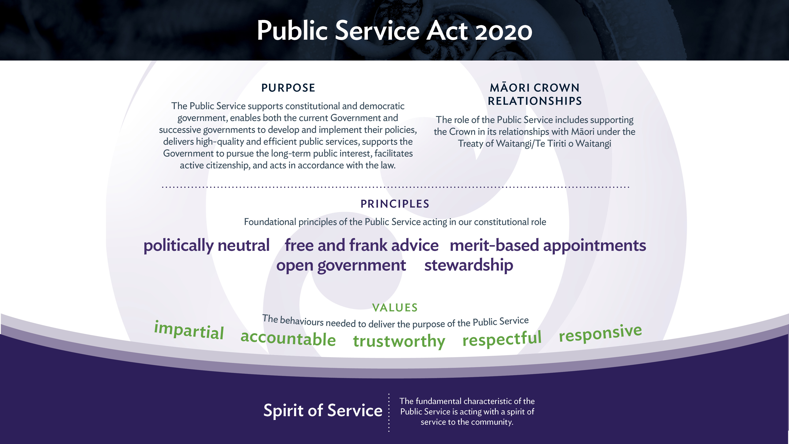

Slide 7
… you have thought about how the principles and values affect other types of Crown entity
The principles and values make sense for all public sector boards and support the Code of Conduct
Crown entities experience a high level of public scrutiny and accountability. A Crown entity board is directly accountable to Parliament, and the Chair may be summoned to answer select committee questions on conduct and performance. The Official Information Act and Public Records Act apply
More generally, Crown entities are often much more in the public eye than a commercial or non-government organisation, often with strong media interest
The Crown Entities Act sets out specific requirements of boards and directors on issues such as conduct and integrity that go beyond those required of commercial or NGO boards
Ministers expect their Crown entity to behave prudently and sensitively, and in keeping with public sector values
Notes:
See s. 66 of the Act. - An exception to these requirements may be made when the board chair is satisfied that it is in the public interest to allow a member with a "specified class of interest" to act despite their interest in a matter (s. 68). In order to allow this, the chair must give prior written notice to the Board, and the exception must be published in the annual report. The Minister may give this permission if the chairperson, deputy or temporary chair is unavailable or themselves interested.
Boards should have formal processes for identifying, declaring and registering interests (s.64), which includes maintaining an interests register. Interests are not static: a board member’s circumstances will change over time, as may the activities and focus of the entity. So, interests need to be kept under review, and added to or removed from the entity’s register as necessary.
As good practice, boards should include an item on interests as a regular part of their meeting agendas and ensure interests are documented in meeting minutes.
Board staff also should be aware of declared interests so the distribution of meeting papers can be adjusted accordingly.
A board member failing to disclose a known interest is likely to breach the duties to act in good faith, to act honestly, and with care, diligence and skill. Such a breach of duty is a basis for removing a board member.
There are some legislative variations, for example between the Crown Entities Act and the Public Health and Disability Act (for DHB members), on participation by board members with an ‘interest’.

Slide 8
….. you understand that political neutrality matters
As an apolitical Public Service, our reputation stands and falls on being trustworthy, transparent and impartial. It is vital public servants adhere to the expectations placed on them and maintain the trust and confidence of New Zealanders
Trust is important. It provides legitimacy for the Public Service to act, to serve communities and improve the lives of New Zealanders.
The New Zealand Public Service enjoys high levels of public trust and confidence, and is focused on delivering better services and outcomes for New Zealanders.
There can also be greater scrutiny of the actions of the Public Service during an election year, and it is important that we maintain our high standards of integrity and conduct and the political neutrality of our agencies.

Slide 9
… and having high standards of conduct for board members and for employees
The Commissioner has issued a Code of Conduct for Crown Entity Board Members
New board members should become familiar with their board’s policy manual or charter; in particular, its standards of integrity and conduct setting out explicit expectations in relation to potential probity issues.
Boards should satisfy themselves that their entity’s own code of conduct and practices reflect the principles of the Standards of Integrity & Conduct for the State Services and related expectations (for example, on offers of gifts & hospitality), and should endorse their adoption for all entity employees.
Notes:
The Public Service Commissioner may set minimum standards of integrity and conduct for a range of agencies, including all or any Crown entities except CRIs and TEIs and their subsidiaries. The Standards of Integrity and Conduct issued by the Commissioner seeks to:
reinforce a spirit of service and set common standards of behaviour required from the diverse range of people and roles across the State Services
provide a framework within which to make informed judgements when faced with competing interests and conflicting values – when the ‘right answer’ is not readily apparent.
Crown entities covered by the Commissioner’s integrity and conduct mandate must:
comply with the minimum standards of integrity and conduct set out in the State Services Commissioner’s code of conduct
have in place policies and procedures that are consistent with the standards set out in the code of conduct
Each Crown entity board is expected to ensure their organisation complies with the standards of integrity and conduct in the Commissioner’s code of conduct by:
maintaining an infrastructure of policies, procedures, agreements and training that is consistent with and reinforces the standards set out in the code of conduct
providing highly visible leadership of the standards – modelling them and articulating what they mean in the particular setting of the organisation
ensuring staff are imbued with the spirit of service and understand how the organisation gives effect to it
In promoting and reinforcing their own code of conduct, entity management (supported by their board) are expected to :
model ethical behaviour
deal decisively with breaches of the code of conduct
encourage an environment where individuals feel it is acceptable to openly discuss issues of integrity and conduct
ensure staff regularly participate in training on the code of conduct and on integrity and conduct issues generally
advise the State Services Commission about serious alleged or actual breaches of the code of conduct, as well as advising the monitoring department and/or responsible Minister

Slide 10
…. You have read and understood the Code of Conduct for Crown Entity Board Members and relevant Model Standards
The Public Service Commissioner has issued:
a Code of Conduct for Crown Entity Board Members which applies to the board members of statutory entities (excluding corporations sole) and Crown entity companies (excluding Crown Research Institutes and their subsidiaries)
a Code of Conduct for the Directors of Public Finance Act 1989 Schedule 4A Companies.
The Commissioner’s Model Standards
Model Standards set out the Commissioner’s minimum expectations for agencies and staff in the public sector on specific integrity areas. These include:
Positive and Safe Workplaces , Information Gathering and Public Trust, Speaking up, Conflicts of Interest, Chief Executive Gifts, Benefits and Expenses, and Workforce Assurance

Slide 11
…… you are aware that during an election year ….
official Information Act requests should continue to be handled in a timely and appropriate manner
public servants intending to stand for Parliament must inform their employer, and stand down from their positions by Nomination Day in the case of staff covered by the Electoral Act
senior staff should exercise particular care in discussing their intentions
agency premises and other resources should not be used for electioneering. See Commission guidance: He Ārahitanga Pōtitanga Whānui | General Election Guidance | Te Kawa Mataaho Public Service Commission.
Notes:
It is never acceptable for public service agencies to organise advertising or publicity campaigns that could reasonably be regarded as encouraging voters to vote, or not vote, in a particular way. (see Guidelines for Government Advertising in the Cabinet Manual)
The Electoral Finance Act 2007 defines election advertising widely. State services agencies including Crown entities are prohibited from publishing election advertising, or from permitting it to be published. Entities should take a conservative approach, to avoid perceptions that public funds are being used in ways that are contrary to legislation.
To preserve the political neutrality of the public service, Crown entities must handle Official Information Act requests in a timely fashion, and only withhold material for reasons allowed under the Official information Act. The Ombudsmen look particularly closely at this during election years.
Crown entity staff who wish to stand for Parliament are entitled to do so, but should advise their manager if they intend to do so. However, if an entity board member or chief executive wishes to stand this will need to be considered on a case by case basis: they should discuss this intention with the board chair and, if necessary, the Public Service Commissioner.
Crown entity premises, vehicles, etc must not be used to display material or carry out activities that could reasonably regarded as party political in nature.

