Slide 1

Public recordkeeping and OIA
Findings from Archives NZ’s annual survey 2019
Chief Archivist Richard Foy
July 2020

Slide 2
Agenda
Public Records Act 2005 (PRA)
Monitoring Framework
Findings from our survey
Relationship with the Official Information Act

Slide 3
Public Records Act 2005
Information is fundamental to open, transparent and accountable government.
The Public Records Act 2005 (PRA) exists to enable government accountability.

Slide 4
Full and accurate records in the PRA
Section 17 covers:
Requirement to create and maintain full and accurate records
  Including the records of any matter contracted out to an independent contractor
  Must be in accessible form throughout lifecycle

Slide 5
Monitoring Framework
New monitoring framework encompasses:
Annual survey
New PRA audit programme
Environmental scanning

Slide 6
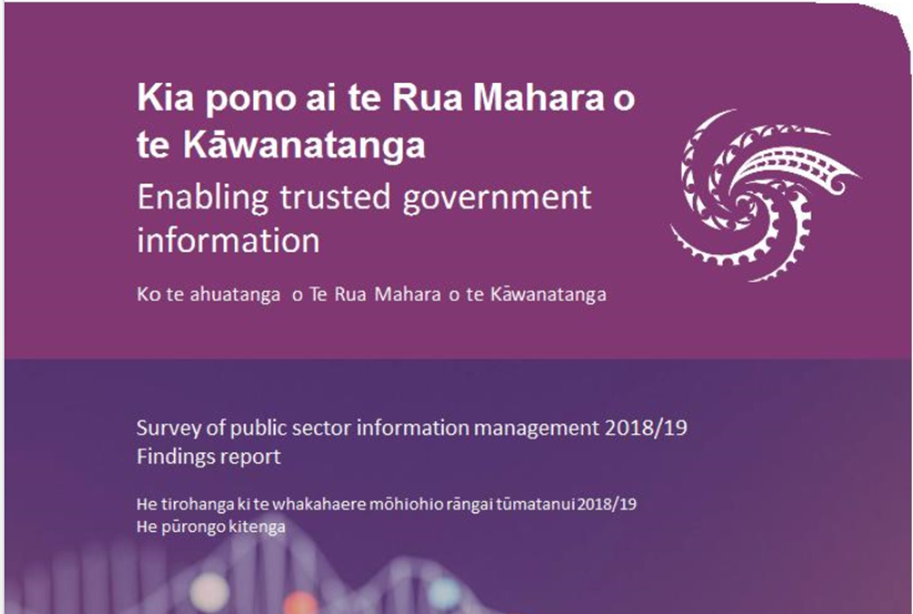
Reporting

Slide 7
Survey benefits
Whole of system view of IM
Benchmarking
Improve our ongoing monitoring and reporting
Service delivery

Slide 8
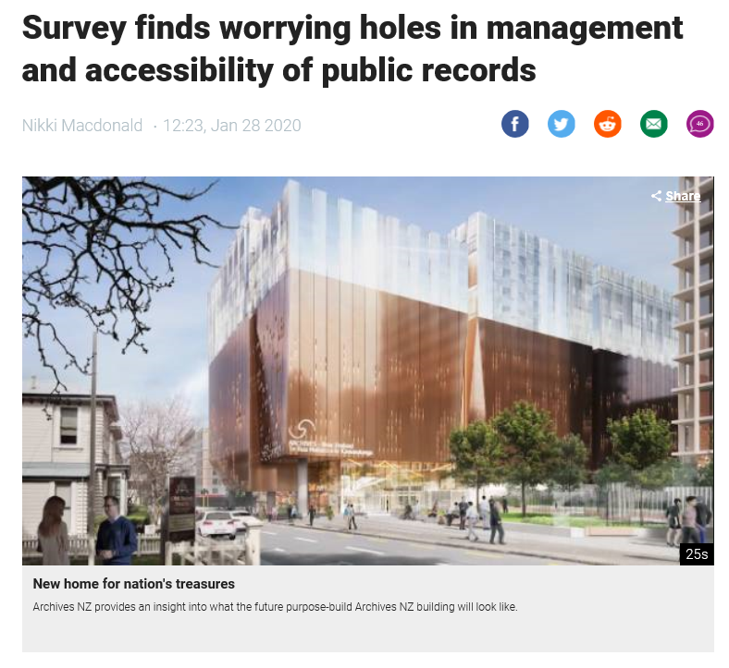
Survey Findings
Major gaps with implications for accountability

Slide 9
IM resourcing

Slide 10
Risks to information

Slide 11
189
Complaints to the Ombudsman (in 2017-18)
82
Related to information that did not exist or could not be found
“Bad systems and practices pull a veil over information, obscuring it from view”
Survey finds worrying holes in management and accessibility of public records; Nikki Macdonald, Dominion Post, Jan 28 2020

Slide 12
2019 survey findings
“One in six survey respondents said that, in the past year, they struggled to answer OIA requests for information they believed existed, but couldn't find.”
Survey finds worrying holes in management and accessibility of public records; Nikki Macdonald, Dominion Post, Jan 28 2020

Slide 13
PRA and OIA
You can’t access information under the OIA if:
It was never created
It’s been filed in the wrong place
Its stored on obsolete technology

Slide 14
What is a public record?
Claire Curran’s voice mail message
Related to an undisclosed meeting
RNZ Chairman refused to release the message
Yes – actually it is a public record

Slide 15

Common themes
Search tools lacking
Legacy systems
Obsolete formats

Slide 16
Official information handling
Lack of training
Issues working between multiple systems
Important meetings going undocumented

Slide 17
In summary
Good governance
Treat information as a valuable asset
Know what information needs to be created and kept
“Careless handling of precious information is a fundamental undermining of democracy” Peter Boshier

