Slide 1
Official Information Forum
25 October 2023:
OIA New Practitioners
Microphones off please, cameras optional

Slide 2
Opening karakia
Whakataka te hau ki te uru
Whakataka te hau ki te tonga
Kia mākinakina ki uta
Kia mātaratara ki tai
E hī ake ana te atākura
He tio, he huka, he hauhū
Tihei mauri ora!

Slide 3
Agenda
1.00pm: Welcome & Context
Olivia Cross, Te Kawa Mataaho Public Service Commission
1.10pm: An introduction to the resources and networks available
Office of the Ombudsman and Te Kawa Mataaho
1.55pm: Break
2.00pm-2.45pm: Expert panel
Office of the Ombudsman, experienced OIA practitioners from DOC, Corrections, HUD and the Police

Slide 4
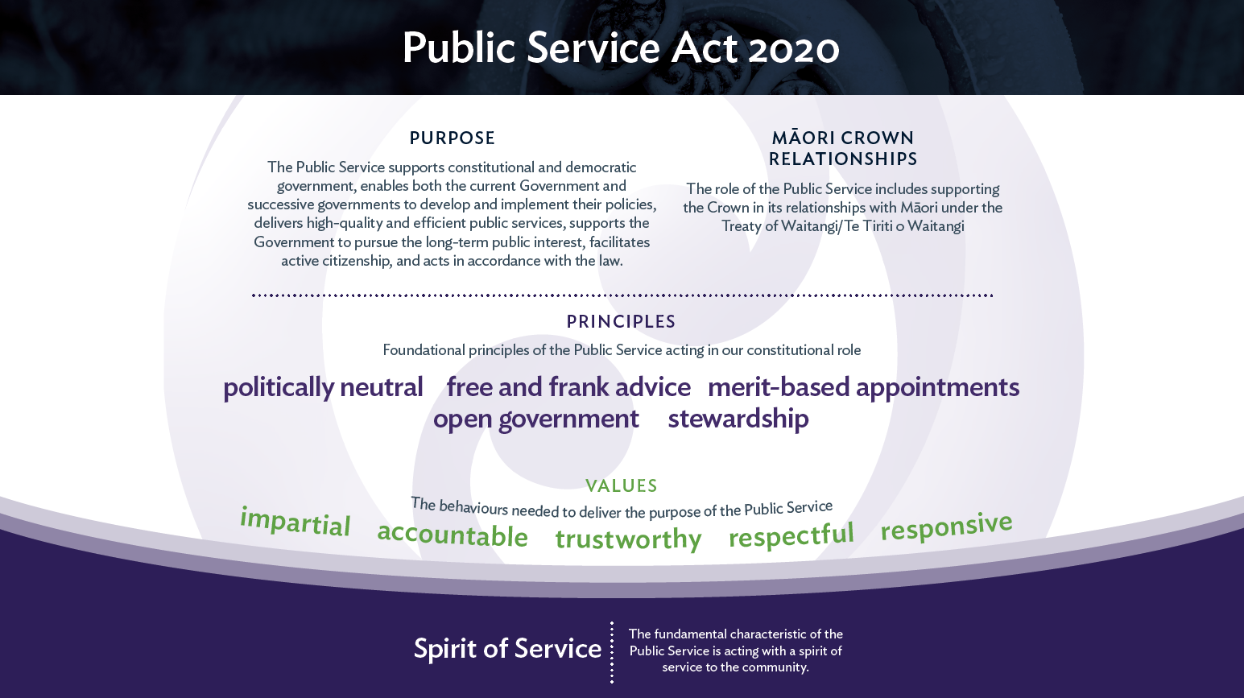

Slide 5


Official Information Forum
October 2023
Ombudsman’s guidance and resources for agencies

Slide 6

Ombudsman roles & powers
Resolve and investigate complaints
(OA, OIA, LGOIMA)
Resolve complaints about Children in Care
Undertake systemic investigations (OA)
Monitor and inspect places of detention (OPCAT)
Monitor performance under Disabilities Convention
Receive protected disclosures under the PDA

Slide 7

Official information legislation
Official Information Act 1982: to progressively increase the amount of official information available to the public
Local Government Official Information and Meetings Act 1987: promote the open and public transaction of business at meetings of local authorities
Notes:
What is the OIA?
The Official Information Act, or OIA, allows people to request official information held by Ministers and specified government agencies and local government agencies.
It contains rules for how such requests should be handled, and provides a right to complain to the Ombudsman in certain situations.
This OIA is an important constitutional document and one of the primary vehicles for promoting transparency and open government. It flipped the Official Secrets Act presumption on its head.
When considering an OIA request, agencies should always start from the premise that ‘information shall be made available unless there is good reason for withholding it’. The OIA also provides for the protection of information when there are specific grounds for withholding information.
The free flow of information is crucial in a crisis to promote trust and public confidence. I’m sure that you will have found this over the past few years while managing communications with stakeholders about Covid-19.
As part of the OI legislation is the Principle of Availability - Information shall be made available unless there is good reason for withholding
Section 4 (Purpose)
To increase the availability of official information:
To enable more effective participation
To promote accountability
To enhance respect for the law and promote the good government/local government in New Zealand
To protect official information to the extent consistent with the public interest and the preservation of personal privacy
Note on Treaty obligations
OIA does not include specific references to the Treaty of Waitangi
Confidential information entrusted by iwi groups to crown / issues of data sovereignty
Confidential information may be covered by Tikanga and release may breach an obligation of confidence and/or harm Crown Treaty relationships/obligations
Balanced against public interest in access to the information – may also be Treaty issues favouring release eg release of information about health outcomes

Slide 8
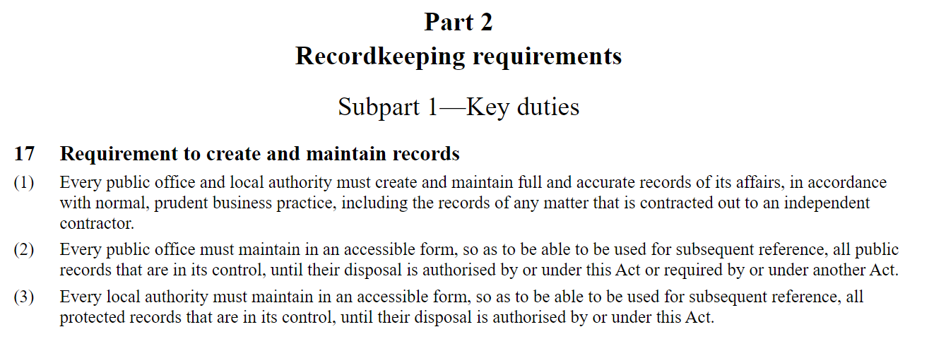
Recordkeeping
Public Records Act 2005, sets out a mandatory requirement for agencies to ‘create and maintain full accurate [and accessible] records of its affairs’
Notes:
evidence/accountability/transparency

Slide 9
Categories of official information
Part 2
requests for official information (three refusal categories)
Part 3
requests for policies, guidelines and rules; and
requests for reasons why a decision was made
Part 4
a request by a corporate entity for information about itself
Notes:
LGOIMA contains a number of different parts which have slightly different rules and procedures for certain types of official information.
PART 3:
Section 22 of OIA/Section 21 of LGOIMA provides requesters with a right to access any document which ‘...contains policies, principles, rules, or guidelines in accordance with which decisions or recommendations are made in respect of any person or body of persons in [their] personal capacity.’ The ability to refuse such a request is very limited.
Section 23 of OIA/Section 22 of the LGOIMA also provides a right to a written statement of reasons for a decision or recommendation made about the requester by the agency. Normally people can only request information which is held by a local authority, but section 23/22 obliges an agency/local authority to create information in order to respond to a request eg, job application.
There are two new guides published recently and available on our website, one concerns requests for internal rules and guidelines, the other requests for statements of reasons for decisions.
s22/21 - https://www.ombudsman.parliament.nz/resources/requests-internal-decision-making-rules-guide-section-22-oia-and-section-21-lgoima
s23/22 - https://www.ombudsman.parliament.nz/resources/requests-reasons-decision-or-recommendation-guide-section-23-oia-and-section-22-lgoima
PART 4:
This part is essentially a carbon copy of the Privacy Act and it relates to companies and incorporated societies. Search the companies register.
Every non-natural person (ie, corporate entity) has the right to access information an agency holds about it under Part 4 of the OIA/LGOIMA.
This provision is left over from the days when OIA/LGOIMA was the sole means by which a person could seek information held by an agency, including information about themselves. Since the Privacy Act came in to force in 1993, all other requests for information about the requester, where the requester is a natural person, fall to be considered under the Privacy Act.
The requirements for an agency to process such requests are more or less the same as for any other request for official information. However, as the requester has a specific right to access any information about itself that can be readily retrieved, the reasons for refusing such requests are more limited.
Special precautions must also be taken when information is released, to confirm the identity of the requester and ensure that the information will only be received by the requester or their authorised agent. The requester must also be advised of their right to request correction of the information released.
There is also a new guide on requests by companies for their personal information.
PART 7 of the Act contains the local authority meeting provisions, which includes requirements for Agendas and reports:
Are available at least 2 working days before the meeting
Special or emergency meetings = available as soon as reasonable in the circumstances
The agenda must indicate the items to be discussed during public excluded session
Minutes
Are available to the public to inspect or copy (on payment of the prescribed amount) at the local authority’s public offices
Although generally complaints to our Office usually relate to exclusions from meetings based on LGOIMA withholding grounds, our ability to investigate them derives from the Ombudsmen Act, rather than LGOIMA.
Anecdotally, there appears to be a level of concern about the appropriateness of many decisions taken to exclude the public. However, conversely, we are also aware that some local authorities are making concerted efforts to reduce their use of public excluded sessions.

Slide 10
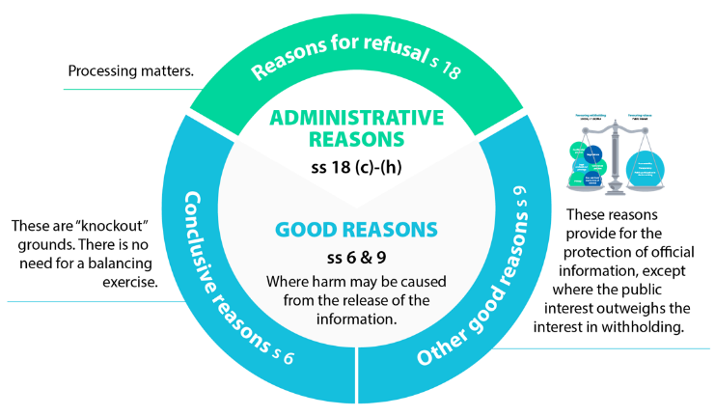
Refusing requests
Whenever you refuse a request for official information you must advise the requester of:
The reasons for the refusal
The grounds in support of those reasons (if requested)
The requester’s right to complain to the Ombudsman and seek an investigation and review of the refusal
Notes:
Administrative reasons – s 18
Release would be contrary to legislation or contempt of court
The information is, or will soon be, publicly available
The information does not exist or can’t be found
The information is not held by the agency
Substantial collation or research would be required
The request is frivolous or vexatious or the information requested is trivial
Conclusive reasons – s 6
If making the information available would be likely to:
Prejudice the security or defence of NZ
Prejudice the NZ’s international relations
Prejudice the maintenance of the law
Seriously damage NZ’s economy
Endanger the safety of another person
Good reasons (public interest test) – s 9
If withholding the information is necessary to protect:
someone’s privacy
a promise made to keep information confidential
the ability of officials to express free and frank opinions in the future
commercial interests
upcoming negotiations
Does not depend on the type of information requested – you need to identify a harm in release

Slide 11
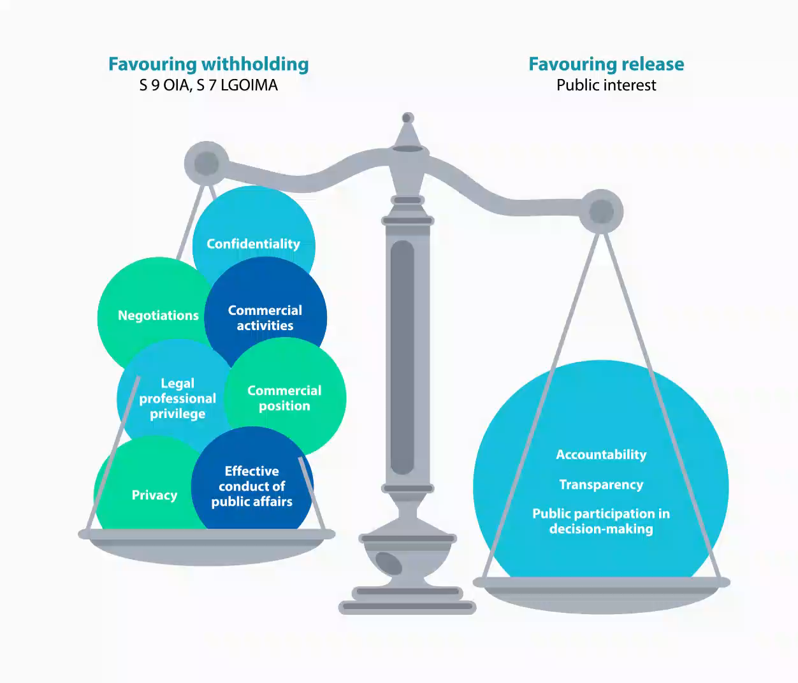
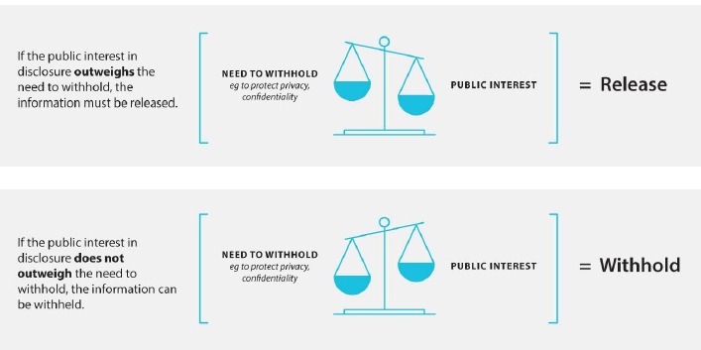

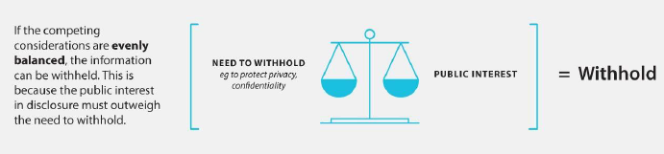
Balancing competing public interests
Notes:
There is a video that plays here

Slide 12
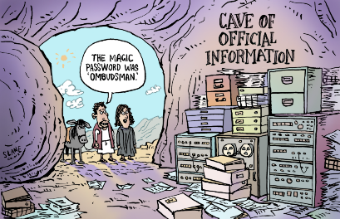
Ombudsman’s review role under the OIA
The OIA grants the Ombudsmen authority to investigate:
refusals of requests
delays (which are deemed to be refusals)
extensions
charges for supply
manner of release; and
conditions on use, communication, publication of information
Other procedural issues may be looked at under the OA (transfers)

Slide 13
Ombudsman approach to OIA complaints
Ombudsman provides independent investigation and review
Look at the agencies decisions on request and its handling
Take an early resolution approach where possible – may ask an agency to reconsider its approach
Investigation not “adversarial’ process – opportunity to improve practices and processes.
Final opinion and recommendation/s

Slide 14
OIA and Media requests
The OIA covers all OI requests to Agencies – including media requests
Be mindful of responding too quickly – ensure you have allowed time to collate and to review the information before making a decision, but there is no reason to delay in responding to a straightforward request
Media and OIA processes need to be aligned
Ombudsman encourages agencies to log/report quick-fire requests – and will improve timeliness figures
Notes:
The OIA does not require a formal or set process for handling OIA requests – agency as a whole gives effect to obligations
All enquiries/requests to media teams do not require transfer to OIA teams
Provide information as soon as reasonably practicable – irrespective of internal process
Identify and triage requests – scope and identify urgency/priority
To collate and review each piece of information against the withholding criteria (as per High court in Kelsey v Minister of Trade [2015]HZHC 2497) – be mindful of refusing too quickly

Slide 15
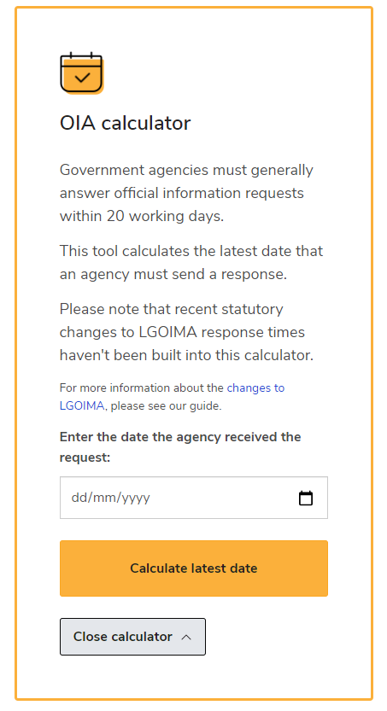
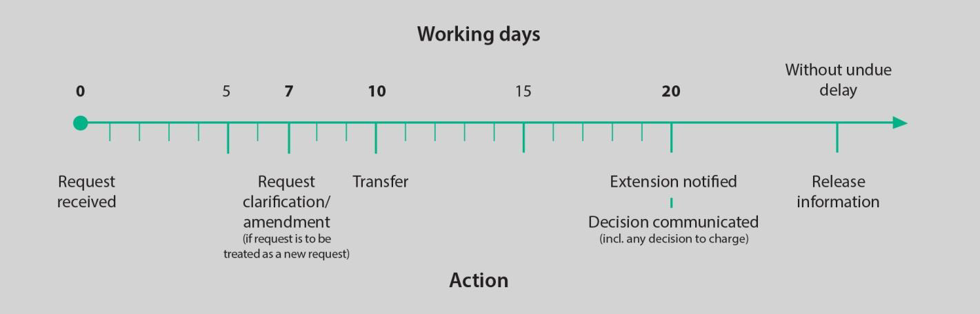
Maximum time limits
Section 15 of the OIA indicates that a request should be answered -
‘As soon as reasonably practicable, or at the latest within 20 working days, after receiving the request’.
Time limits start the day after the request is received.
In the OIA a working day does not include weekends/public holidays or any days between 20 December to 10 January.
Note: a requester can ask for the request to be treated urgently, if they give reason for this.
Notes:
Statutory obligations for OIA requests
To make and communicate a decision to the requester as soon as reasonably practicable and within time limits (20 days or extended)
To provide reasonable assistance to a requester to make a request which can be responded to under the Act (section 13)
To give reasons for any refusal, particularly the OIA section that applies and advise the requester of their right to complaint to the Ombudsman – section 19 OIA
Otherwise, make a decision section 15 OIA and provide the information
To release any information without undue delay (three stages of decision-making)
Requester amends/clarifies own initiative
Becomes a new request if intended to be replace. Otherwise, an additional request.
Agency seeks clarification within 7 days
New request if clarified within 20 days.
Agency seeks amendment outside 7 days – no change in time limit unless agreement reached
Talk to undue delay here – three parts to a request – Collation, decision making, provision of information

Slide 16
Ombudsman approach to Delay Deemed Refusals
The approach to Delay Deemed Refusals (DDRs) focuses on legal obligations in terms of statutory timeframes – encourage better agency performance:
Ombudsman more inclined to investigate and form final opinions in this particular area.
Lack of resources is not an excuse for non-compliance with statutory timeframes – need for contingency planning
Also utilise the mechanism in the OIA (extensions)
Effective and adequately resourced OIA systems and processes.

Slide 17

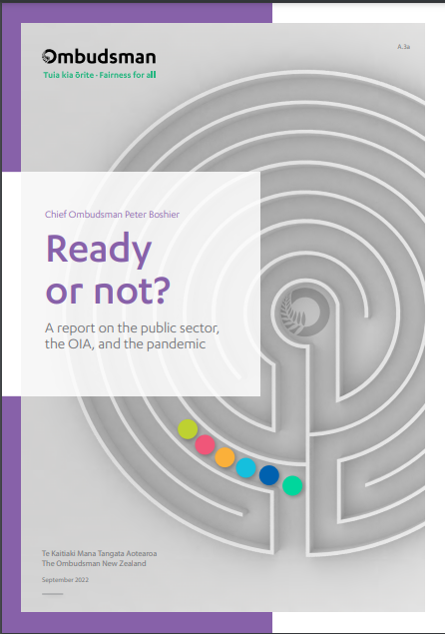
OIA ‘Own Motion’ Investigation
“Ready or not” revisited the original 12 agencies from Not a Game of Hide and Seek
Overall, core public service is increasingly transparent and open -proactive release BAU
Improvement areas (resourcing, media requests, training, ministerial notifications and “reasonably practical”, record-keeping in general).

Slide 18
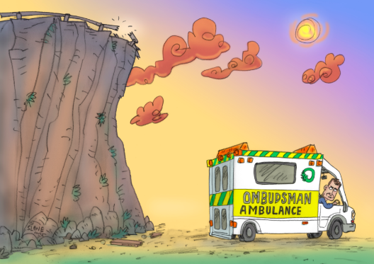
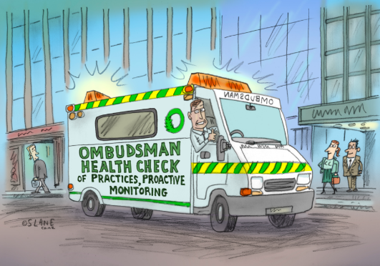
The Ombudsman and their role
Ko Te Kaitiaki Mana Tangata me tāna mahi
The Ombudsman’s compliance role – investigation and review
Ombudsman’s training and guidance functions
Notes:
But the Ombudsman is not just here for when things go wrong – you as public sector agencies can also contact the office for advice and guidance before you make decisions or develop new policies and processes to reduce the likelihood of complaints being made in the future.
With that in mind I hope that what you take away from this talk is to make you aware of the resources available from the Office of the Ombudsman website.

Slide 19
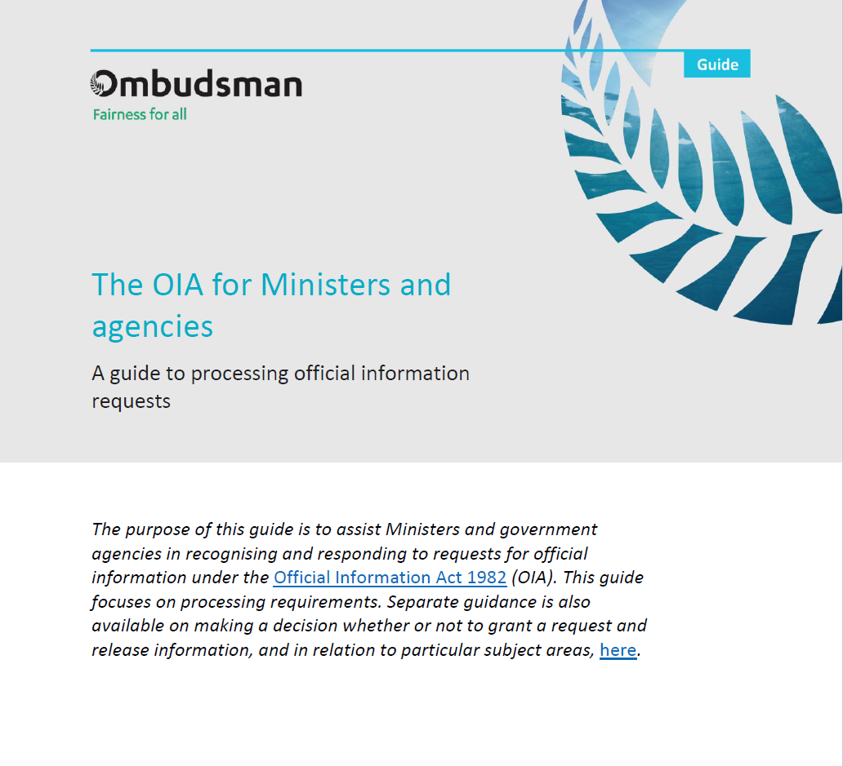
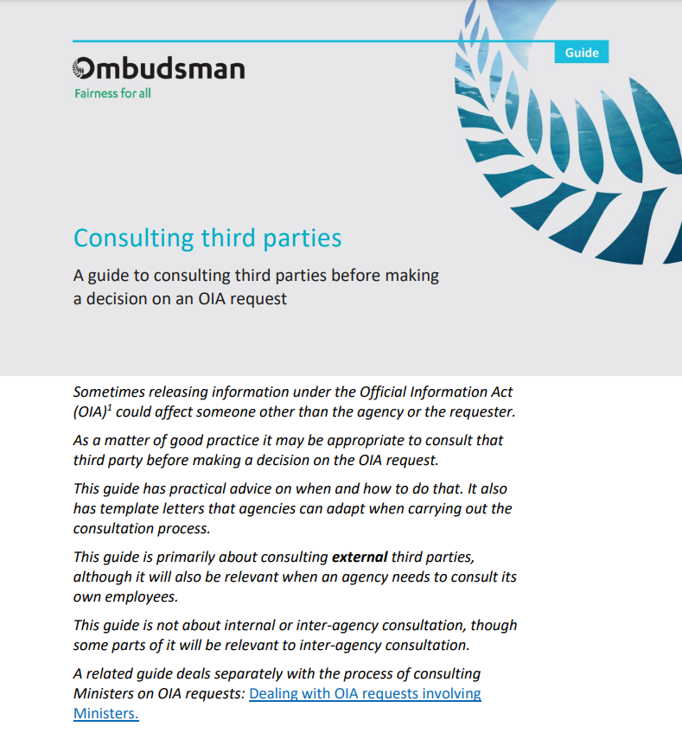
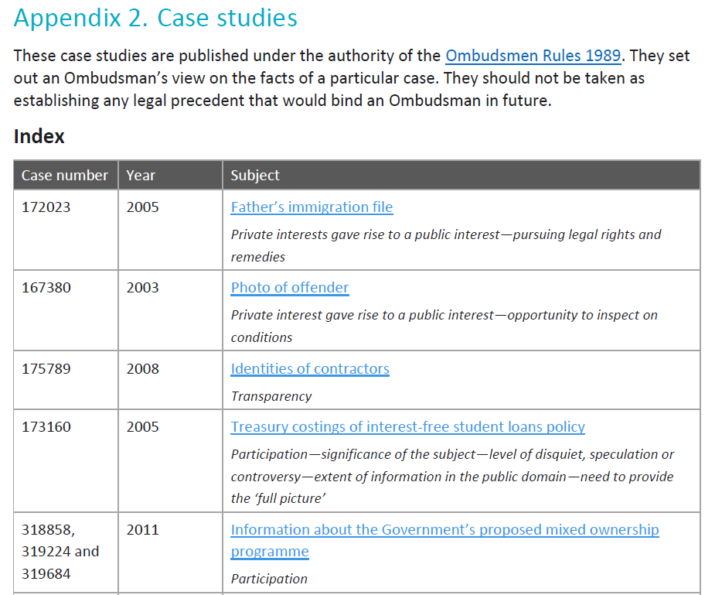
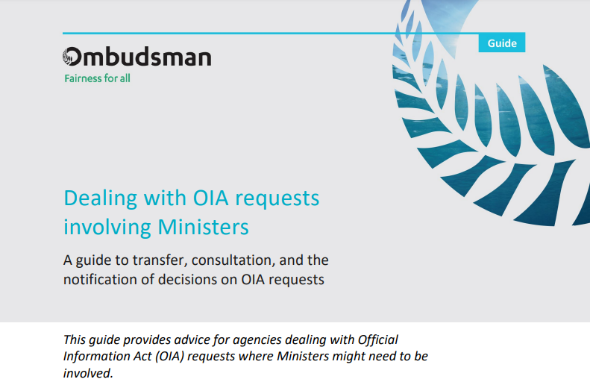
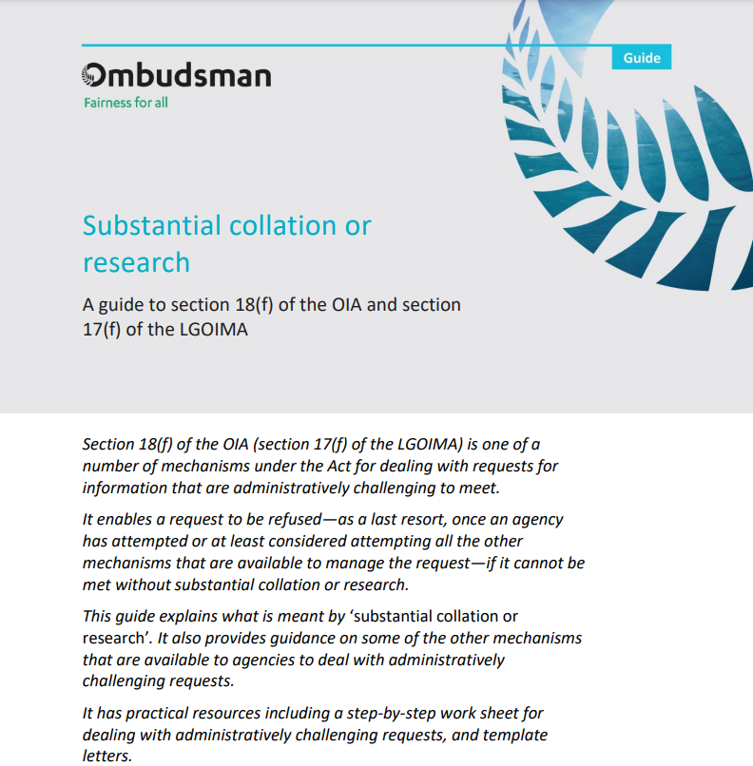
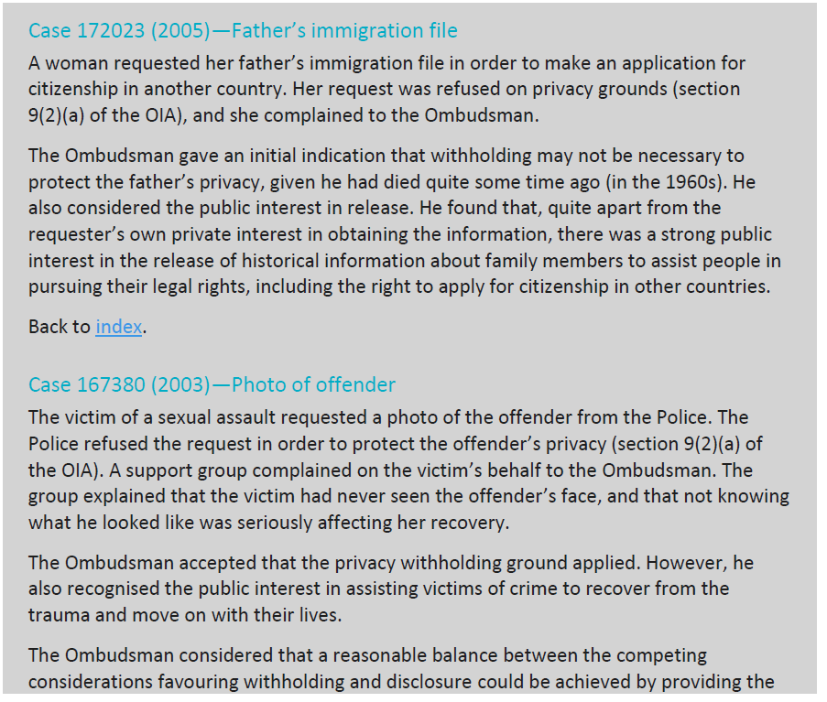
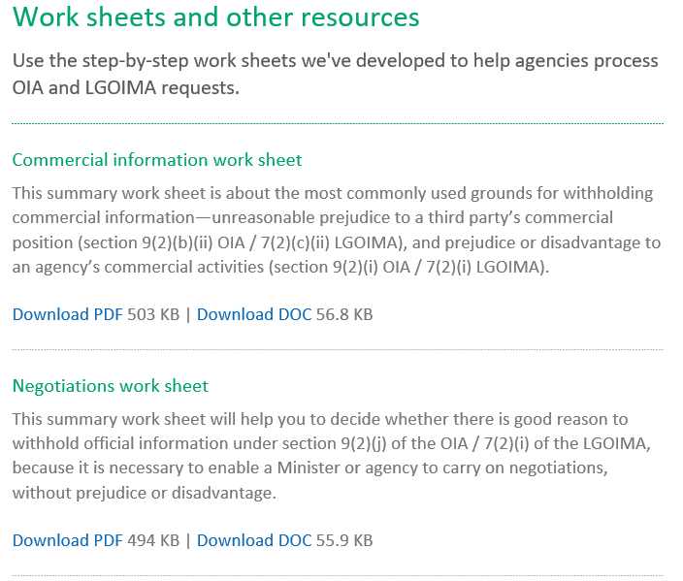
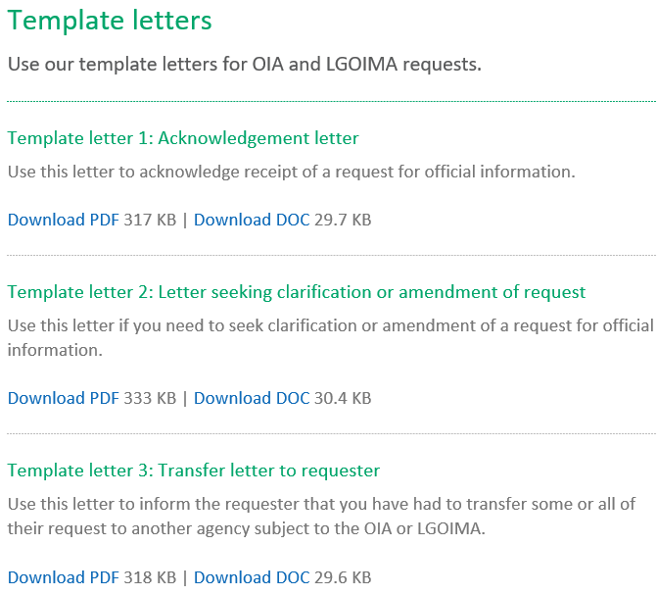
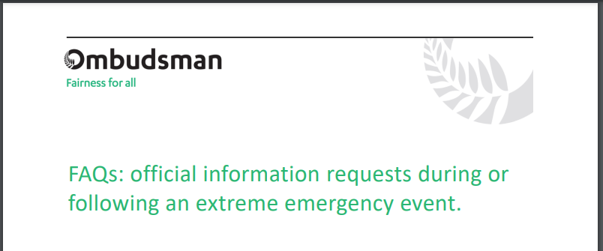
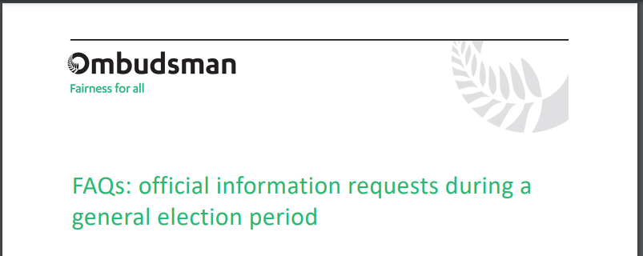
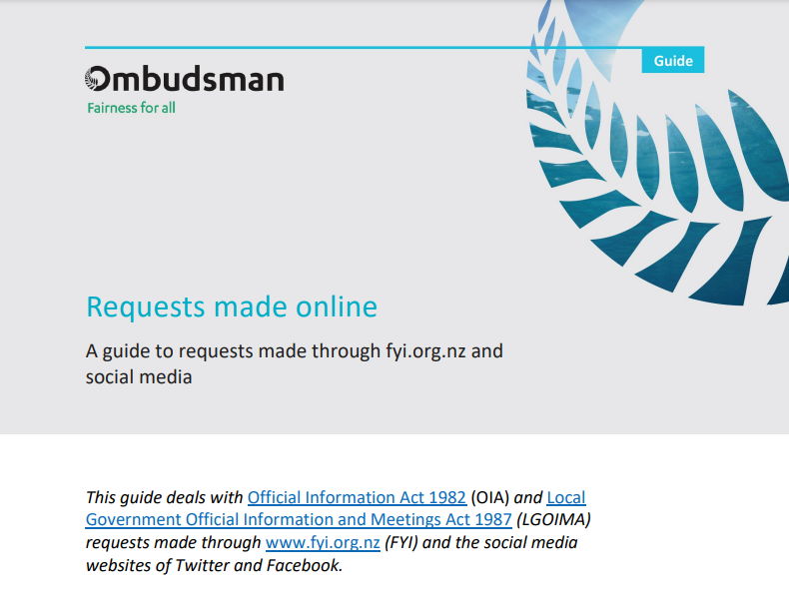
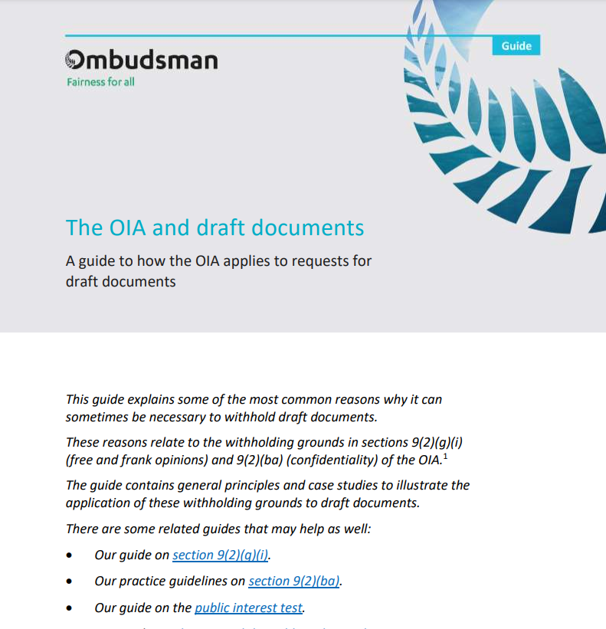
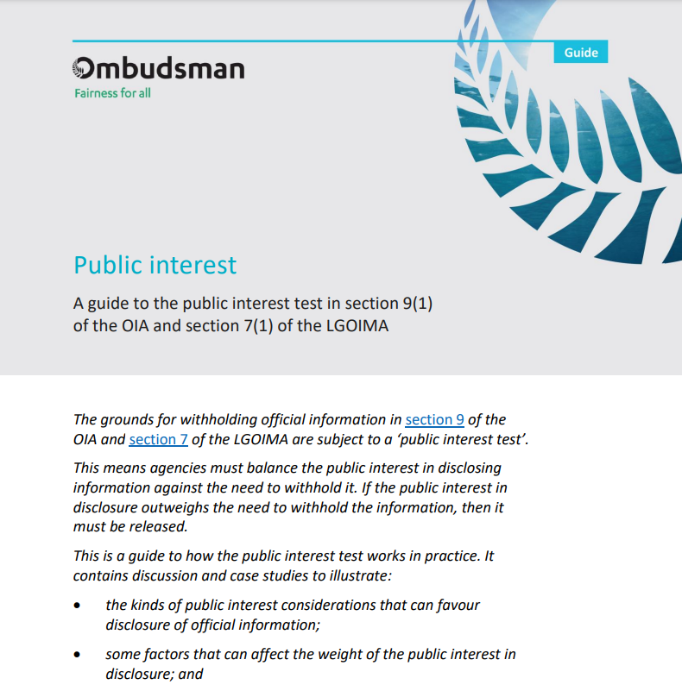
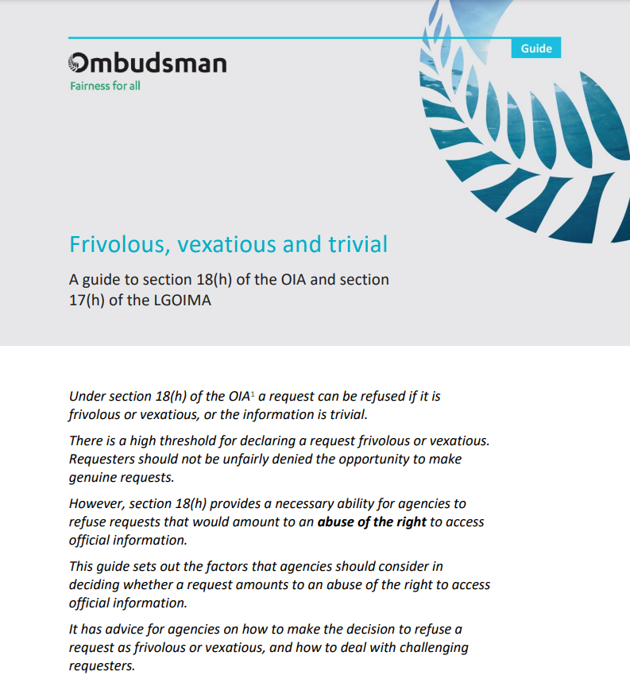
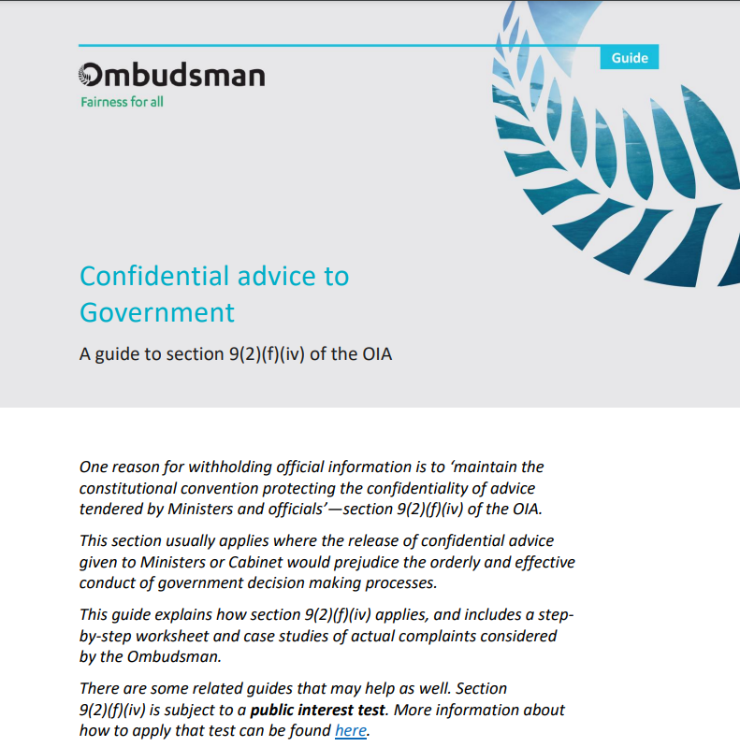
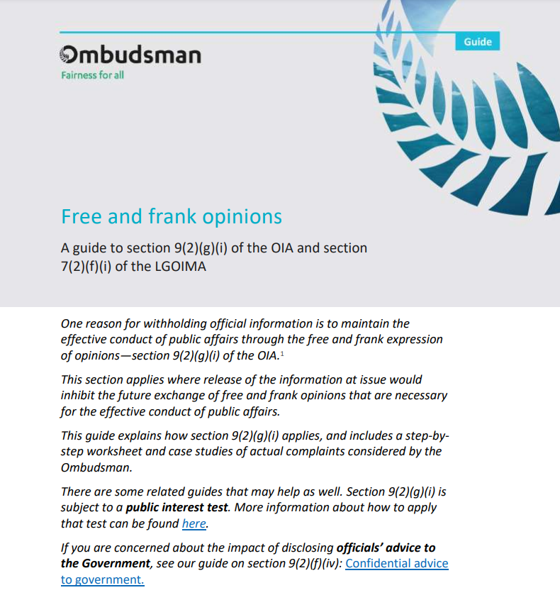

Resources for agencies
He rauemi mō ngā umanga
The guides typically:
Explain the subject matter
Provide:
  Case studies
  Step-by-step worksheets
  Template letters
Point to any other related guides or opinions and case notes
COMING 2024!
Notes:
Published guides include:
The OIA for Ministers and agencies
Consulting third parties
Substantial collation and research
Free and frank opinions
Confidential advice to government
Frivolous or vexatious requests
The public interest test
Draft Documents
Requests made online
FAQ Election
FAQ emergency situations
This image also includes snips of Case studies, worksheets and templates – and a coming soon - TPM
The Ombudsman is subject to secrecy in all matters.
Authorised to publish reports under the Ombudsman Rules in the public interest: Opinions/case notes
No strict doctrine of precedent. However Ombudsmen often consider previous cases to be highly persuasive.
Published case notes often inform the Ombudsman’s early resolution approach to complaint handling

Slide 20

Advice and training
Kupu āwhina me te whakangungu
What the Ombudsman helps with
The Ombudsman can give you advice, clarification, or training on:
  the OIA or LGOIMA
  good administration and decision-making
  proactive release of information
  developing policies and procedures
  managing unreasonable complainant conduct
  developing or changing your internal complaints handling process.
Notes:
Published guides include:
The OIA for Ministers and agencies: A guide to processing official information requests
Consulting third parties
Substantial collation and research
Free and frank opinions
Confidential advice to government
Frivolous or vexatious requests
The public interest test
Draft Documents
Requests made online
FAQ Election
FAQ emergency situations
This image also includes snips of Case studies, worksheets and templates – and a coming soon - TPM
The Ombudsman is subject to secrecy in all matters.
Authorised to publish reports under the Ombudsman Rules in the public interest: Opinions/case notes
No strict doctrine of precedent. However Ombudsmen often consider previous cases to be highly persuasive.
Published case notes often inform the Ombudsman’s early resolution approach to complaint handling

Slide 21
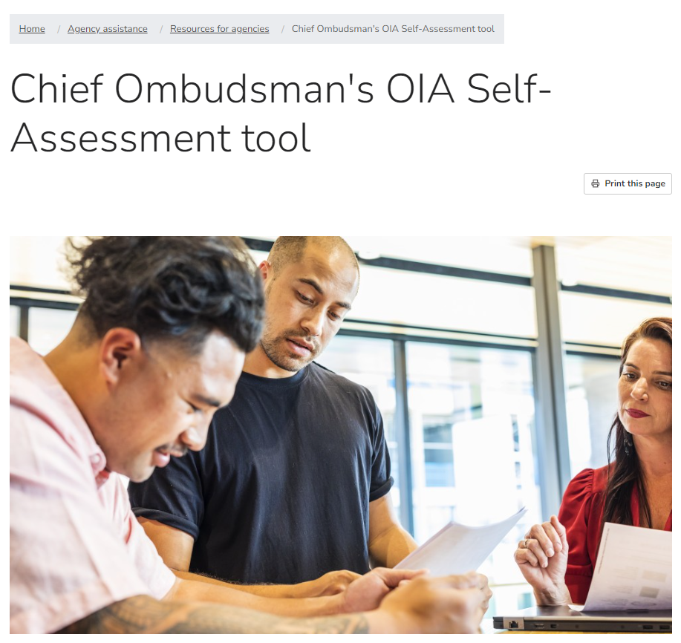

Slide 22
Agency assistance
Āwhina umanga
Ph: 0800 802 602.
Email: info@ombudsman.parliament.nz
Website: http://www.ombudsman.parliament.nz

Slide 23
Official information resources and networks

Slide 24
Te Kawa Mataaho - Official information work programme
Three key areas aimed at lifting agency performance:
Compliance with the letter and spirit of the Act
Proactive release of information
Building capability
Expectations:
Chief Executives of agencies covered by the OIA drive the changes needed to improve compliance with the letter and spirit of the Act.
Strong, coordinated leadership from the Public Service Commissioner and the Chief Ombudsman, supported by CEs, is critical for driving up system performance.

Slide 25
Why a focus on proactive release?
Supports greater openness and transparency in government
Enables the public to understand and engage with decision-making
Strengthens accountability of decision makers and the advice provided by the Public Service
Ideally leading to…
Increased trust and confidence
Higher engagement
Increased participation in democratic processes
Consistent with the spirit of the OIA & the principle of availability: information shall be made available unless there is good reason for withholding it.

Slide 26
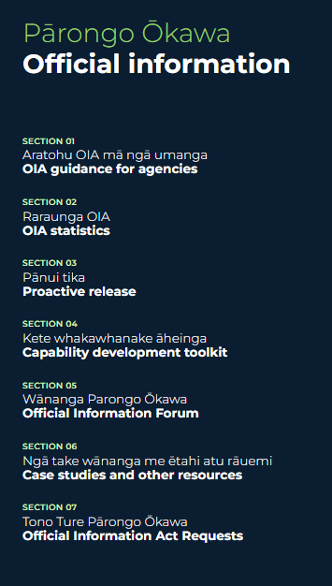
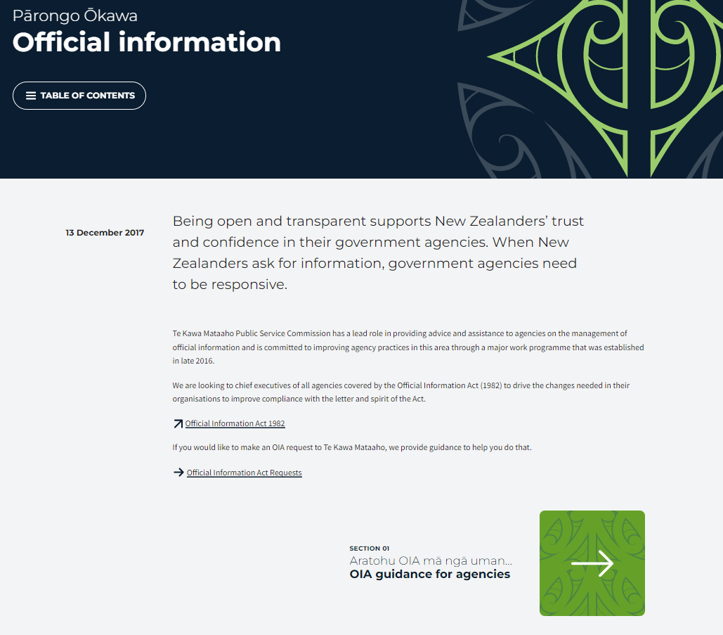

Slide 27

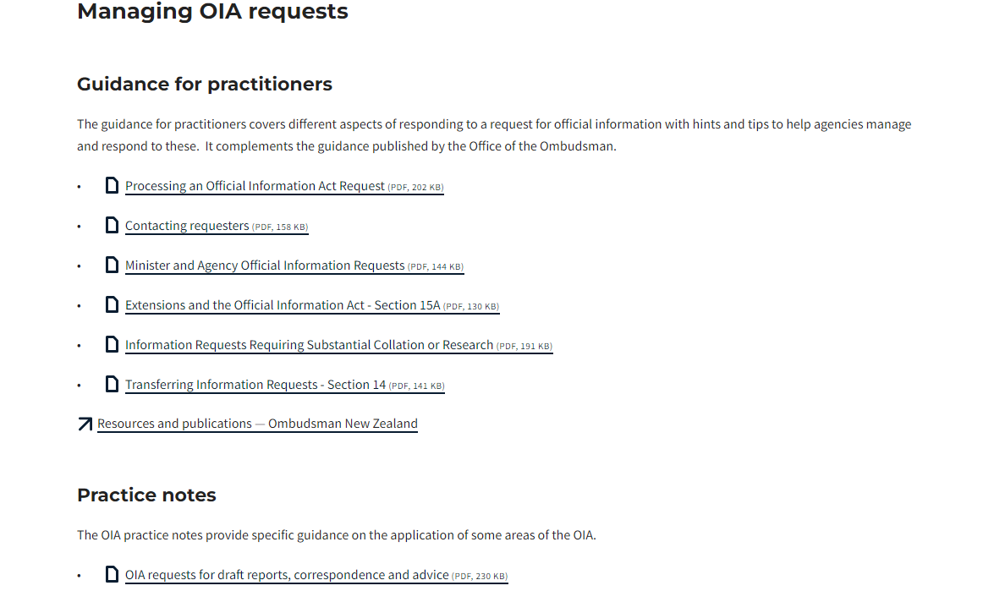
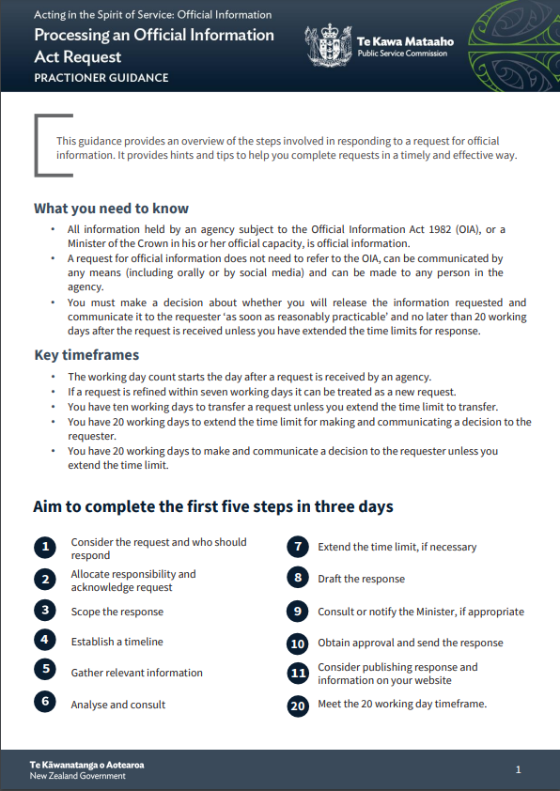

Slide 28

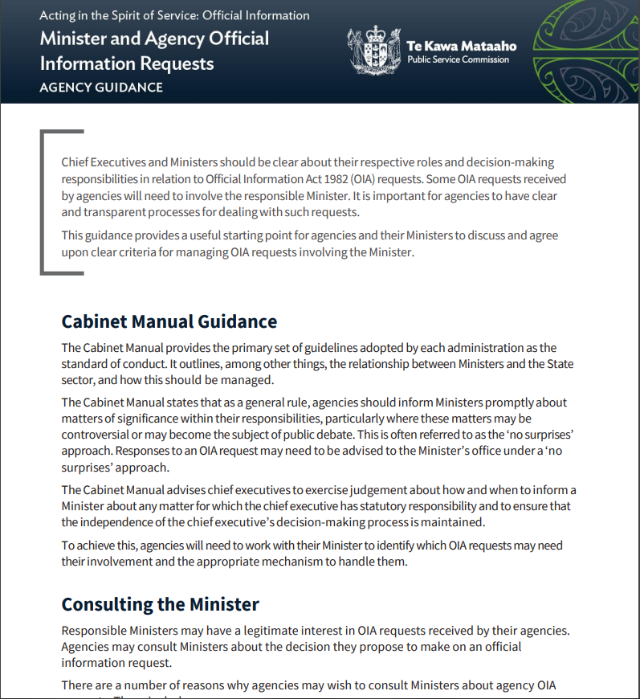
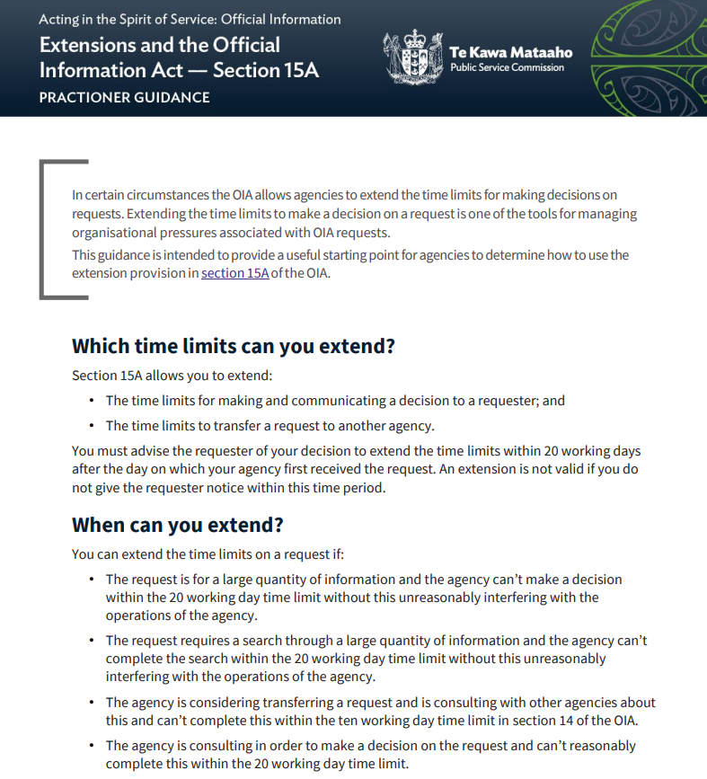
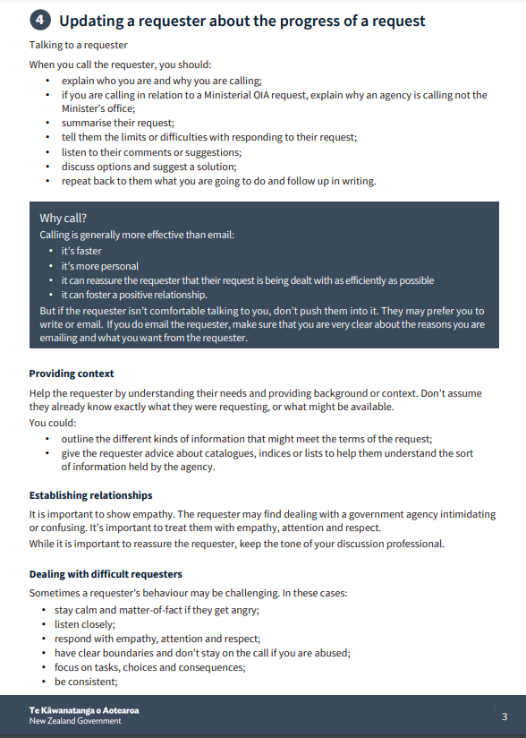

Slide 29
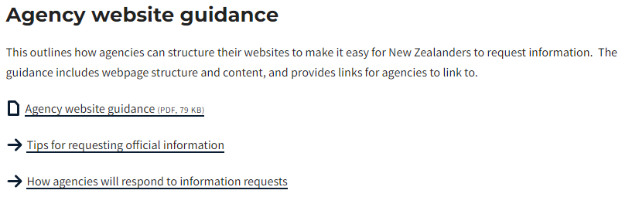
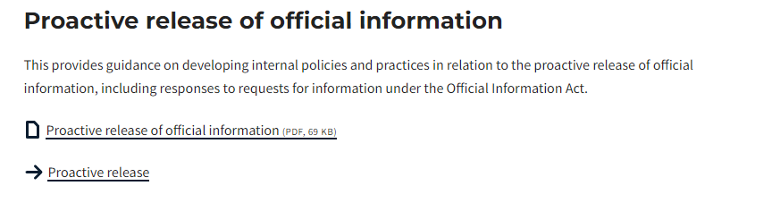

Slide 30

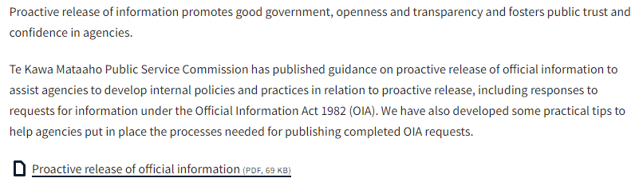
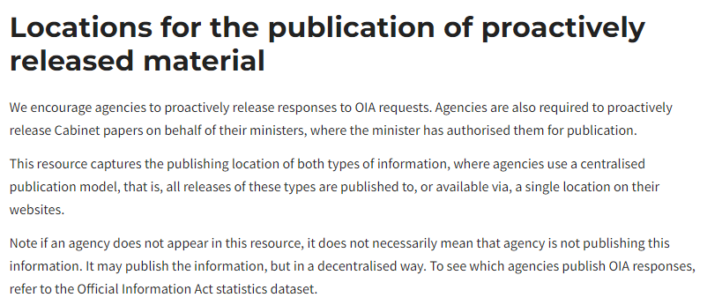

Slide 32
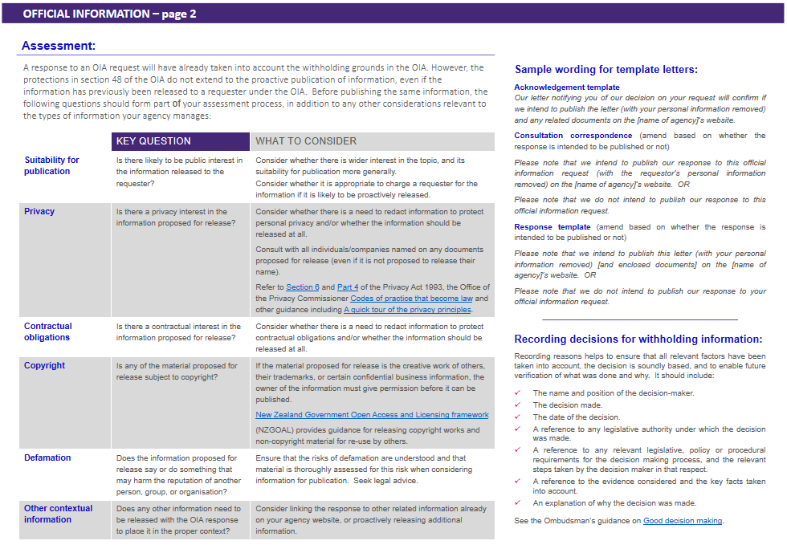

Slide 33

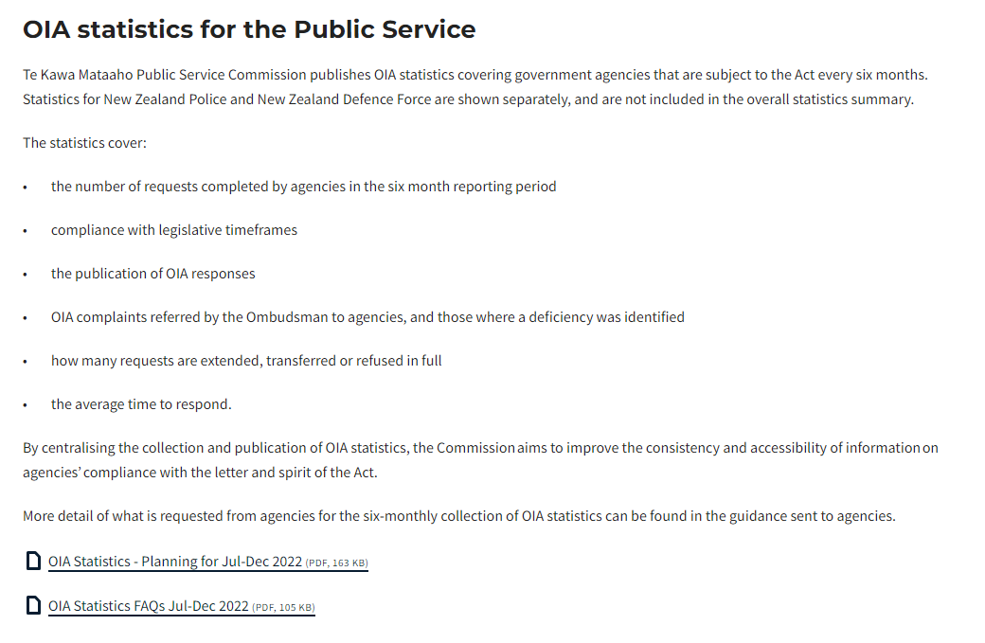
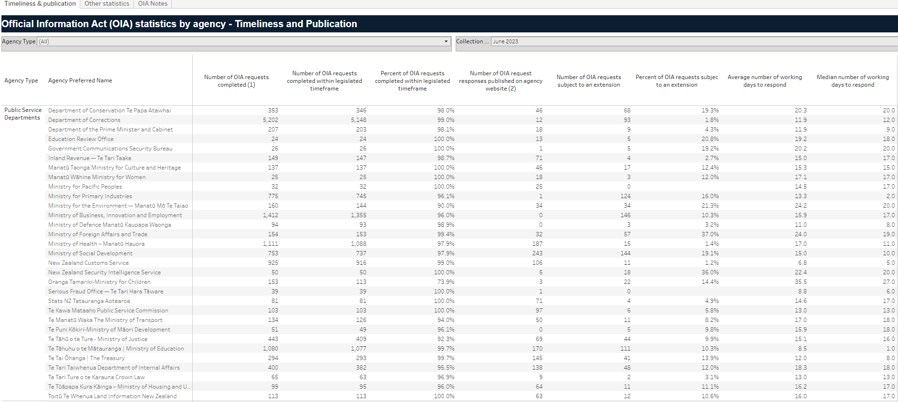

Slide 34
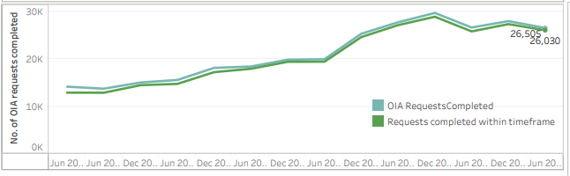
Official Information Act statistics to June 2023
99 agencies (101 when Police and NZDF are included)
26,505 requests. This is a 5% decrease in volume on the previous six months.
98.2% of requests were completed on time - first time over 98%.

Slide 35
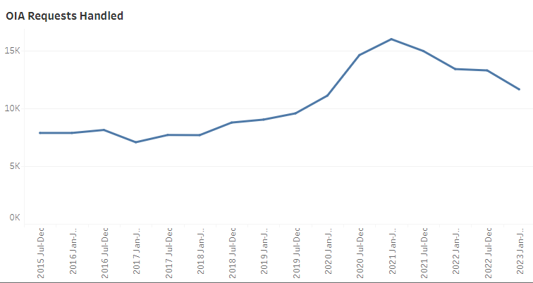
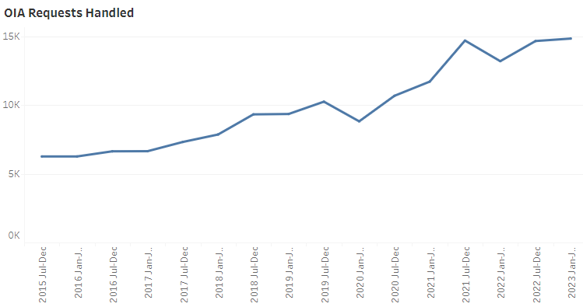
Official Information Act statistics to June 2023
Crown entities
Departments

Slide 36
Extensions
Extensions: 7.5% of all requests.
Down 1% from 12 months ago.

Slide 37

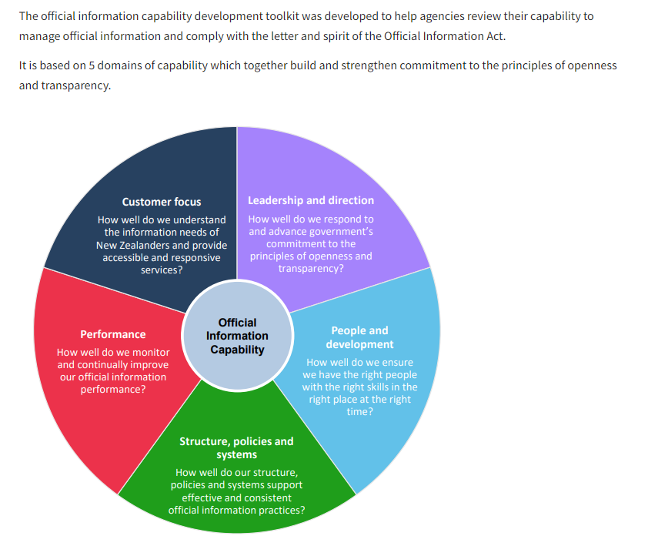

Slide 38
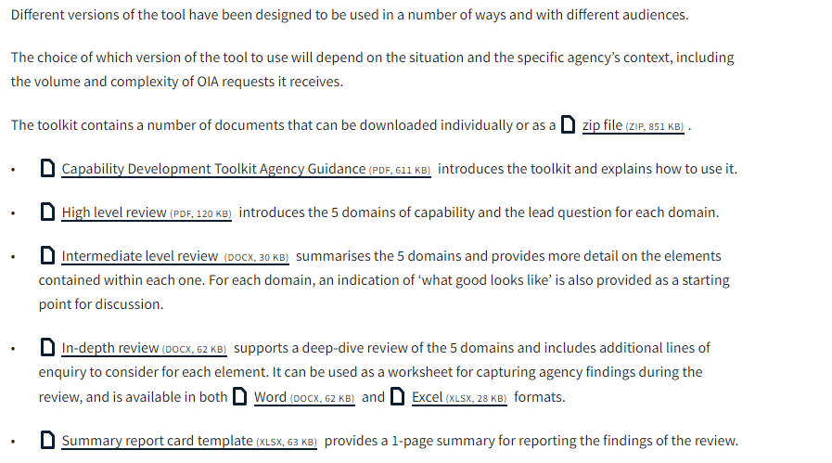

Slide 39

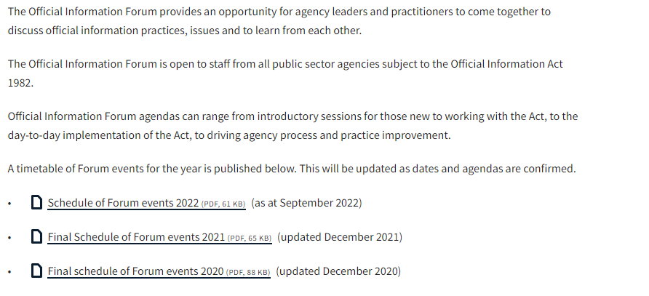

Slide 40
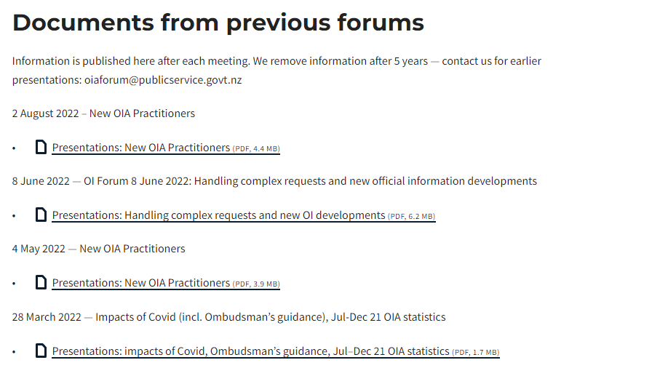

Slide 41
Here to help
If you need advice or assistance, contact the team on OIAForum@publicservice.govt.nz
Or check out the online resources:
http://publicservice.govt.nz/official-information

Slide 42
Panel Discussion
Office of the Ombudsman
Department of Conservation
Department of Corrections
Ministry of Housing and Urban Development
New Zealand Police

Slide 43
Pātai?
Final questions?

Slide 44
Closing karakia
Unuhia, unuhia
Unuhia ki te uru tapu nui
kia wātea, kia māmā,
te ngākau, te tinana, te wairua i te ara takatū
Koia rā e rongo, whakairia ake ki runga
Kia tina! Hui e! TĀIKI E!

Slide 45
Ngā mihi nui
Ka kite anō

